Slide 1
21D83M-843
Single Stage Integrated Furnace Control
Lennox Family Brand Replacement

Slide 2
Business and Product Overview

Slide 3
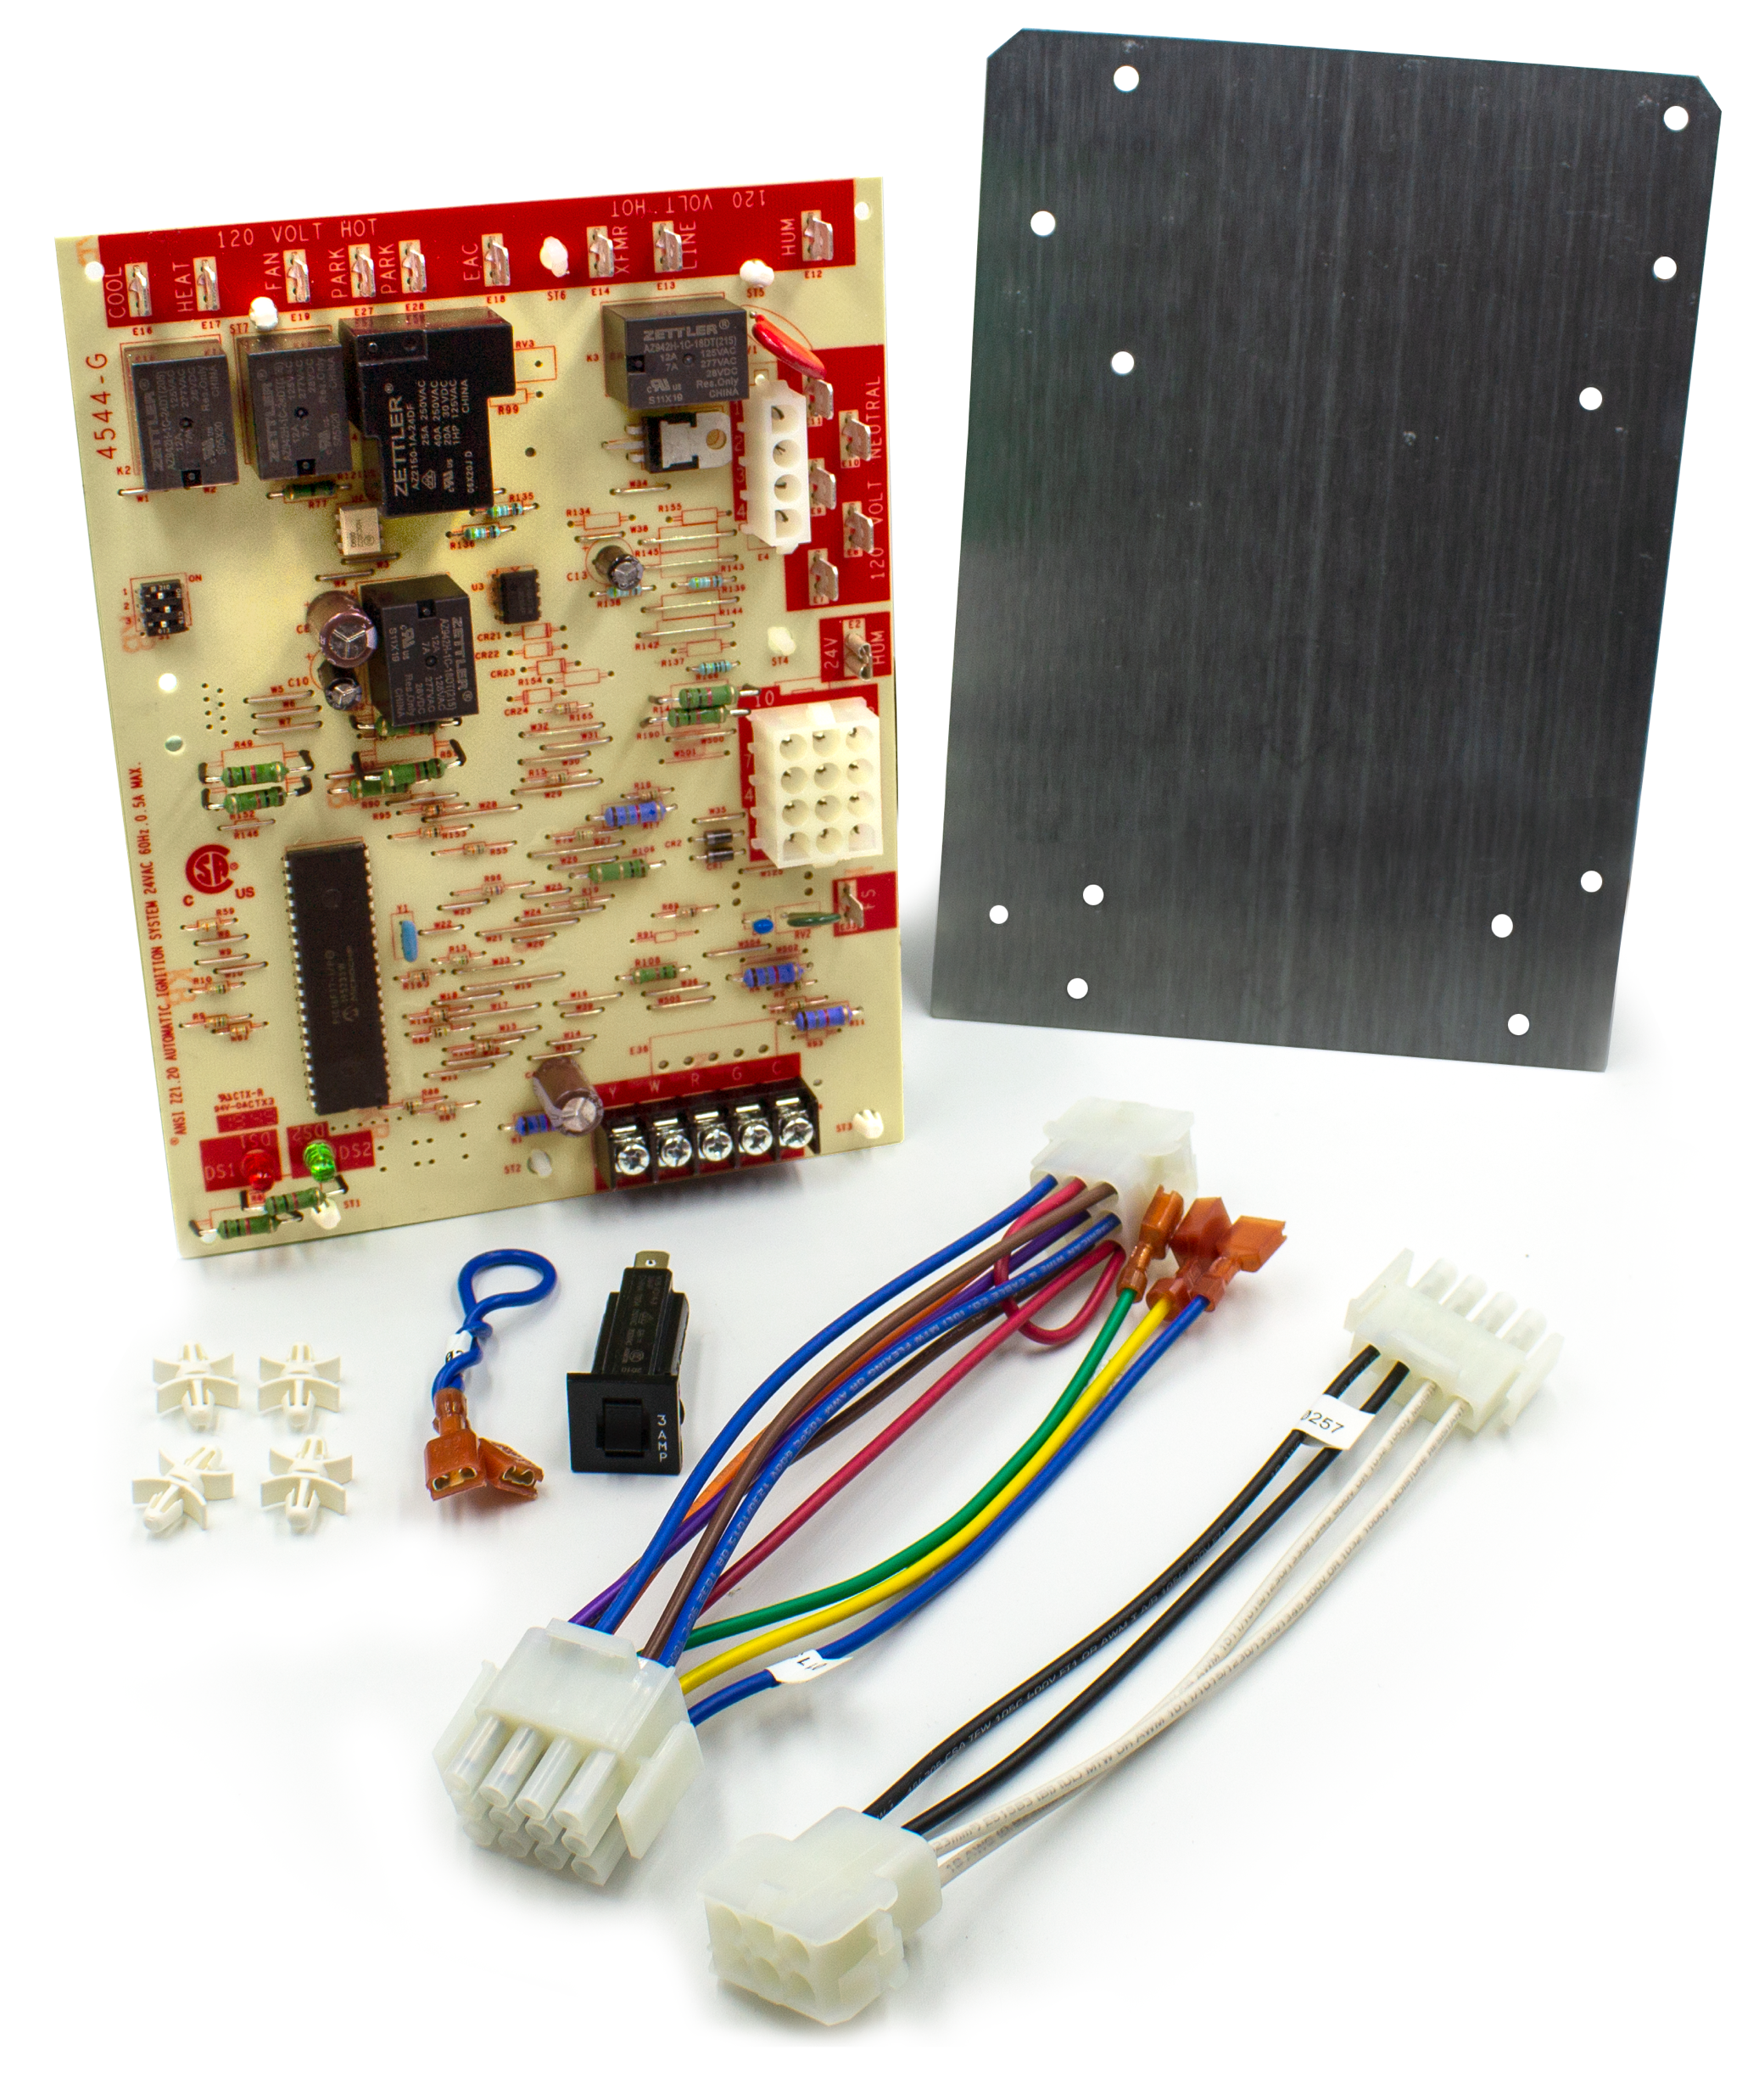
What is it?
The 21D83M-843 is designed to replace the large number of aging Lennox single stage integrated furnace controls in the field
The kit is a direct drop-in replacement for many models and includes adapter harnesses and plug-in circuit breaker for added application versatility
Designed for 80V Nitride ignitor systems with single stage PSC blower and inducer motors
Includes LED diagnostic indicators for quick installation and easy system troubleshooting
21D83M-843
21D83M-843 Single Stage IFC

Slide 4
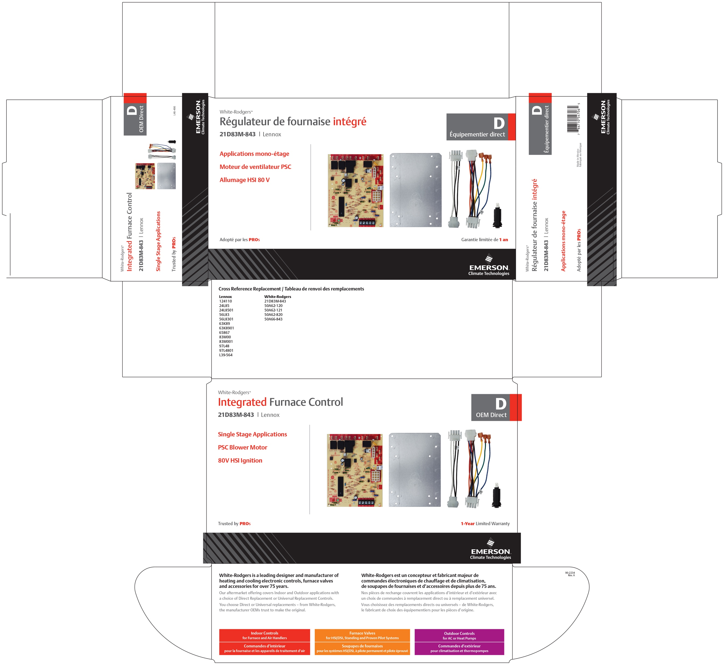
Key Features
Replaces over 40 sku’s
Direct drop-in for most systems with conversion harnesses and circuit breaker to fit additional Lennox applications
Status & fault LED indicators
Blower Delay Dipswitches
Connections for accessory humidifiers and electronic air cleaners
Complete instructions and easy wiring
21D83M-843 Single Stage IFC

Slide 5
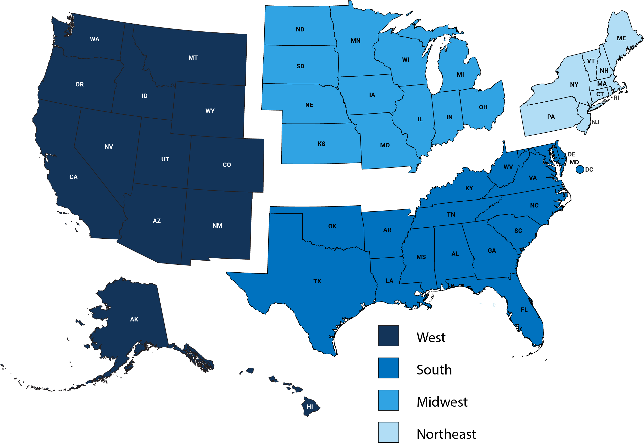
Market
The US market for single stage applications offers a huge opportunity for replacements.
21D83M-843 targets high volume older Lennox brand units that featured 80V nitride ignitors
Single Stage Homes Total: 42,065,000
11,120,000
11,220,000
7,910,000
11,815,000
40 million* single stage gas furnaces were installed in the last twenty years in the US, so the replacement market for these controls should be strong, wherever you are.
*WR Estimate
21D83M-843 Single Stage IFC

Slide 6

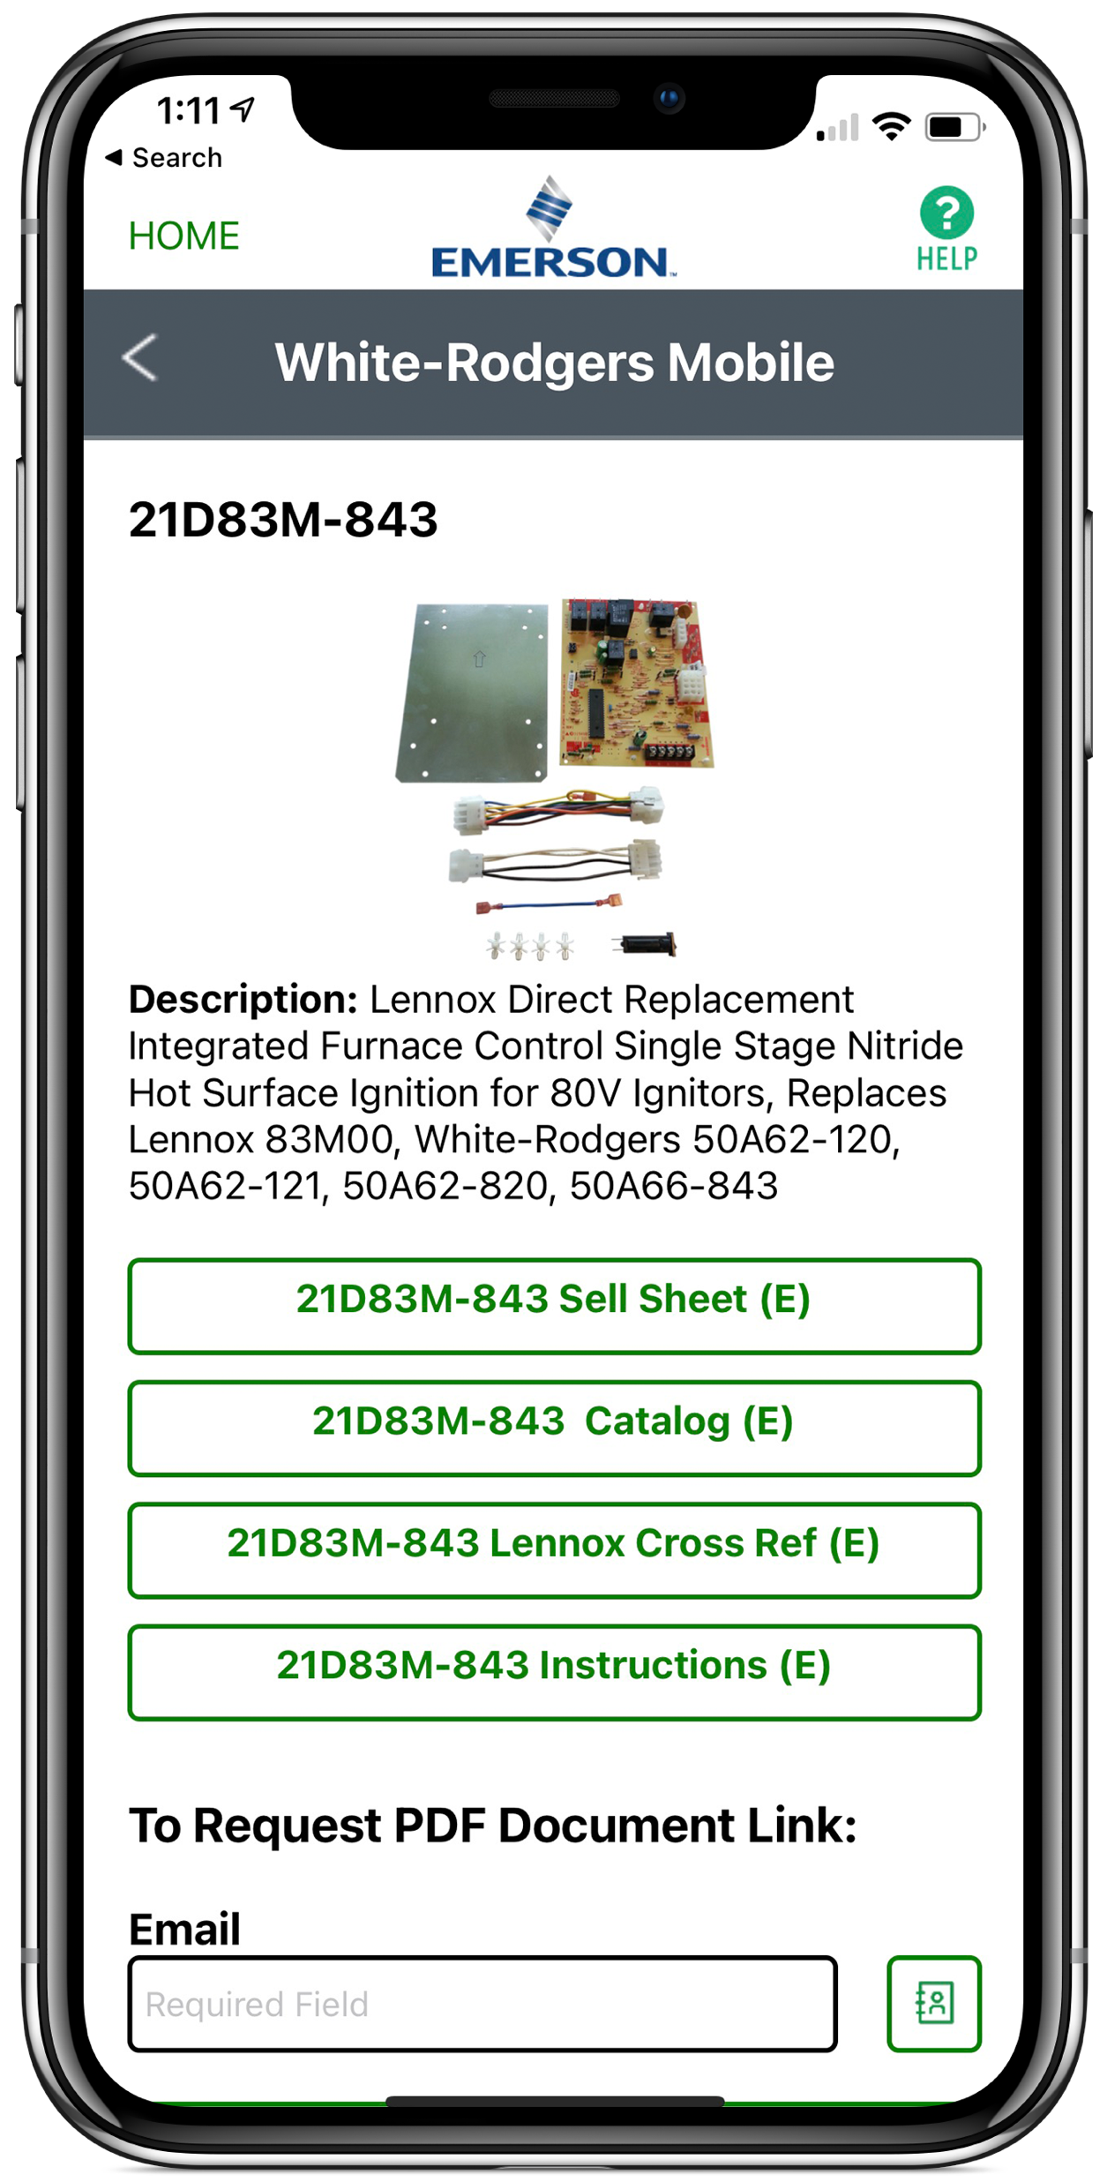



21D83M-843 Cross-Reference
Cross-Reference
Download WR Mobile for most complete and up-to-date cross reference
Check the cross reference list on the side of the box
21D83M-843 Single Stage IFC

Slide 7
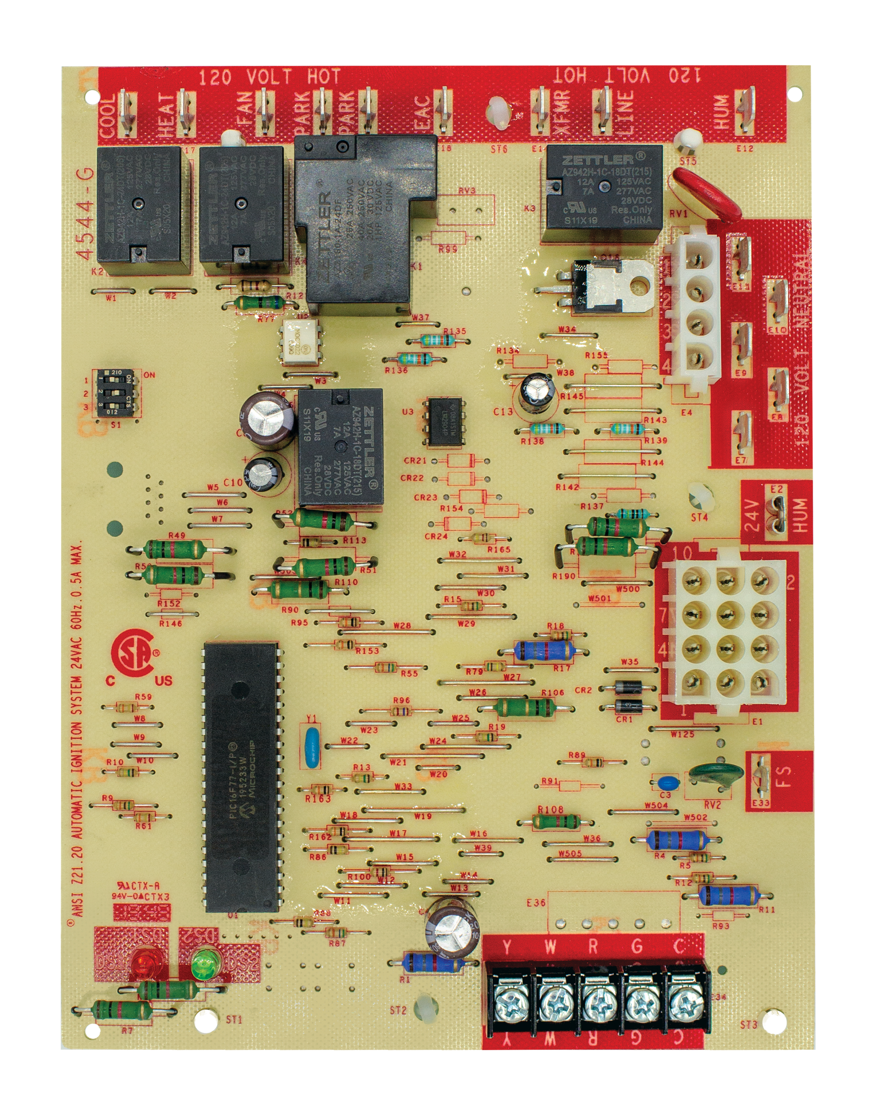
Features and Benefits
Feature | Function | Benefit
40+ board cross references | Saves inventory space – multiple boards replaced with just one control | Minimizes truck stock
80V Ignitor voltage output | Direct replacement for older 80V controls | Minimizes truck stock/saves time
Extra motor/park terminals | Provides safe landing for extra motor lead wires without having to cut off connectors and seal wire ends | Gives technician quick way to secure extra wires
Electronic air cleaner connection | Powers EAC when fan comes on | Saves time installation time
Humidifier connections | Powers Humidifier on heat call | Saves time installation time
Status & fault LED indicator | Pinpoints system problems during installation and in service | Allows technicians to rapidly troubleshoot and resolve component or connection issues
Multiple OEM mounting options with standoffs and plate mount included | Provides mounting stiles to match original | Saves installation time
21D83M-843
21D83M-843 Single Stage IFC

Slide 8
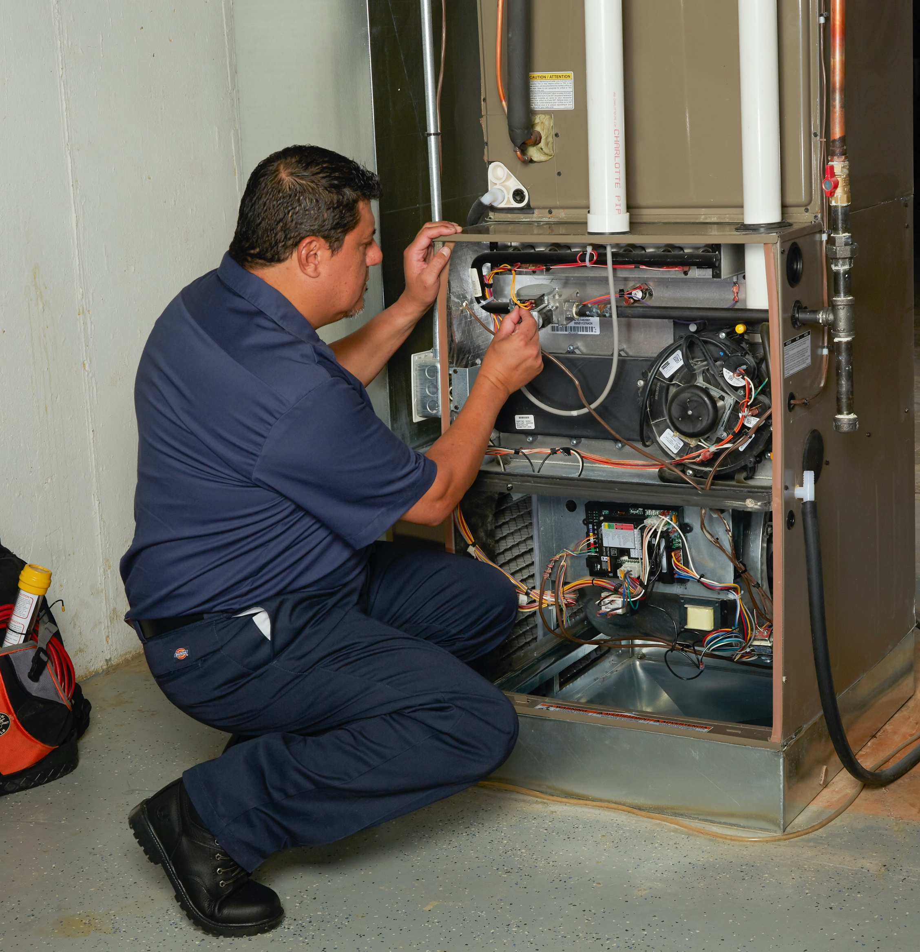
What Our Customers are Saying About
White-Rodgers Integrated Furnace Controls
I would buy this item again for sure!!!
This is a fantastic replacement for the previous SureLight board that was problematic. It came with everything needed and was very easy to install. Very pleased with this board and Supply Warehouse for having it available and ready to ship which was fast.
– Kevin R., November 2021
Works perfectly as a replacement for my older Lennox board.
Came with everything I needed; mount board, standoffs, extra wiring, etc. Some wasn't needed as I just used the existing wiring, but it was still nice to have. The mounting board did have holes that aligned opposite of my config (upside down), but it wasn't a big deal.
– Lee, December 2021
Year later, this board still functions great. Great replacement for original Lennox.
Great replacement for original Lennox G40UH-36A-070X furnace control board that was shutting off after overheating. Installation was easy, instructions were sufficient and easy to follow. This product saved me a lot's of $$. Thanks White-Rodgers!
– I., 2018
21D83M-843 Single Stage IFC

Slide 9




WR Mobile App
Always up-to-date and easy to use:
Mobile App
White-Rodgers Website
Your resource for:
Product information and spec sheets
Complete Cross Reference
OEM compatibility
Installation information and videos
Wiring diagrams
Download:
Go to your app store
Type in WR Mobile
Install the app
OR
Open your camera
Hold it over the QR code
Tap “Open” on the
pop-down
Install the app
21D83M-843 Single Stage IFC

Slide 10
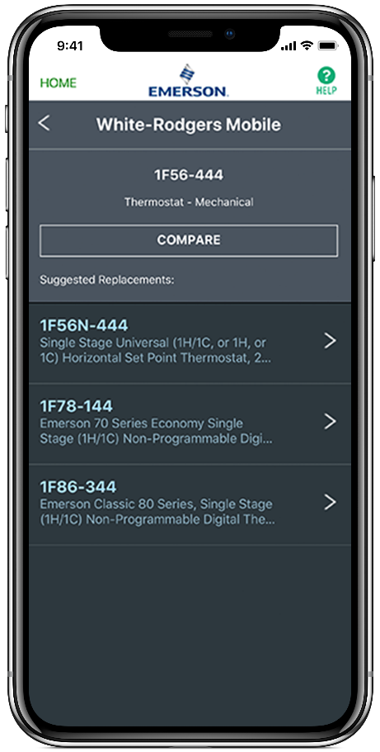
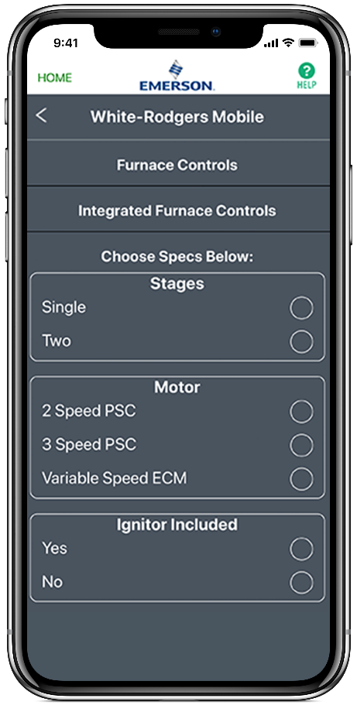
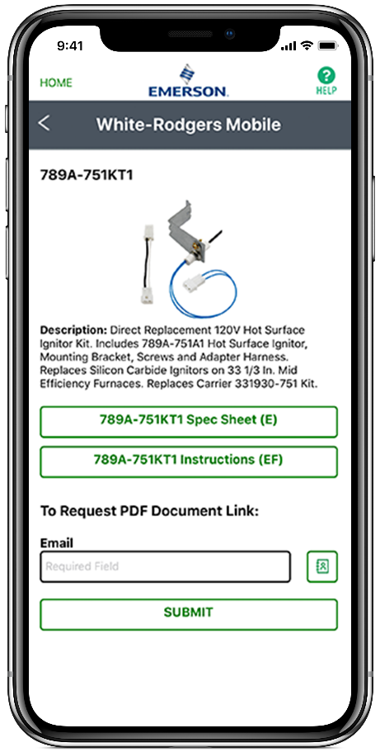
WR Mobile App
Easy to use!
Search by OEM, Competitive, or White-Rodgers Model Number
Product Number
Scrollable Product List
WR Replacement
21D83M-843 Single Stage IFC

Slide 11

White-Rodgers Cross Reference
Go to: www.whiterodgers.com
Hover over Tools & Resources
Click on: White-Rodgers Cross Reference/Product Information
Enter the Model Number or click on: Search Replacement Heating Controls by Major OEM Brand
21D83M-843 Single Stage IFC

Slide 12

Why Contractors Trust White-Rodgers
Industry Leading Products
Used by more OEM’s
Offering the widest range of Universal Replacement Controls
Ease of Installation
Simple, easy to understand instructions
Product Reliability
Quality Control assures reliable products
Affordable
Competitive pricing
Supported by Knowledgeable Representatives
Contractor direct phone support
21D83M-843 Single Stage IFC

Slide 13
Technical

Slide 14
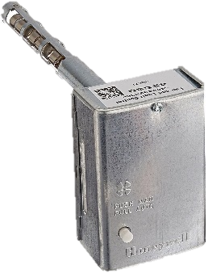
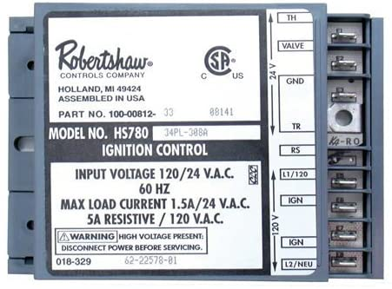
What’s an “IFC”?
IFC stands for “Integrated Furnace Control”.
Originally, furnaces had separate controls for the ignition/combustion process and controlling the blower. IFC’s integrate these functions together. One control monitors and integrates all functions.
IFC jobs include:
Monitoring flue integrity for safe combustion venting
Providing ignition and flame supervision to ensure safety
Operating the combustion inducer motor
Controlling the fan/blower and associated on/off time delays
Monitoring and protecting the furnace from overheating
Interfacing with the thermostat control
Providing pinpoint diagnostic troubleshooting
21D83M-843
21D83M-843 Single Stage IFC

Slide 15
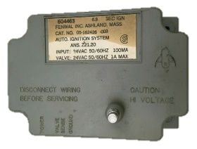
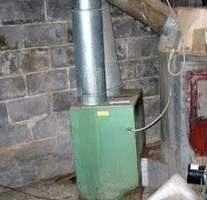
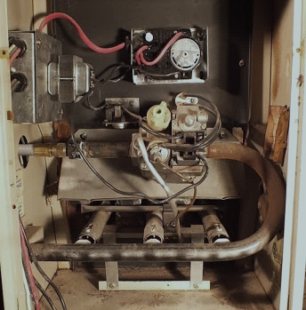
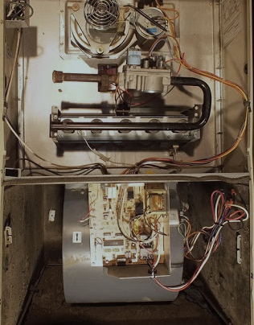
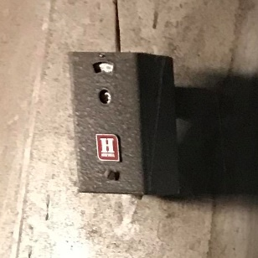

IFC History
1935
1968
1990
1988
An electric fan to distribute the heated air through ductwork of a coal fired furnace within the home is patented.
Mechanical temperature switches are used to control when the blower turns on/off.
An Intermittent Spark ignition system is introduced to replace Standing Pilot Systems.
A Furnace Blower Control using a microprocessor to time the fan blower on & off instead of a temperature sensing control is patented.
A fully Integrated Furnace Control that controls the gas valve, gas ignition, flame sensing, fan blower operation, induced draft control and sensing, & limit function control is patented.
Non-integrated Control Operated Furnaces
Integrated Furnace Control
21D83M-843 Single Stage IFC – Lennox
Notes:
Annual board sales still estimated at 80k-100k
Main users w/ the SmartValve were ICP, Lennox (Armstrong, Ducane), and York (Coleman/Evecon)

Slide 16
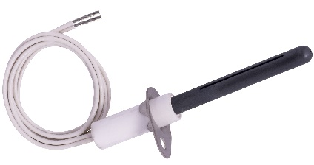
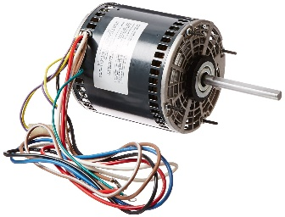
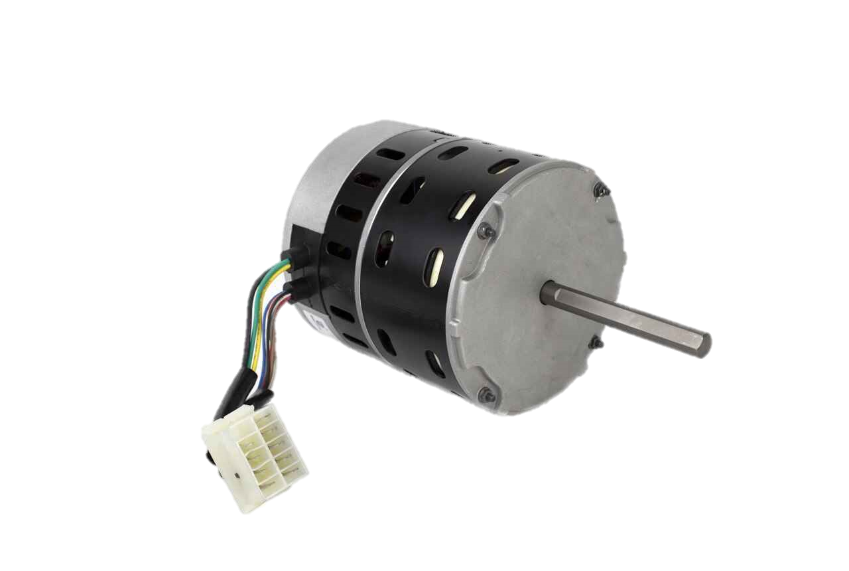
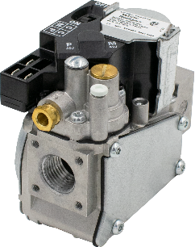
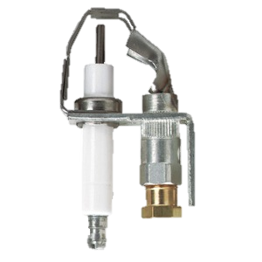
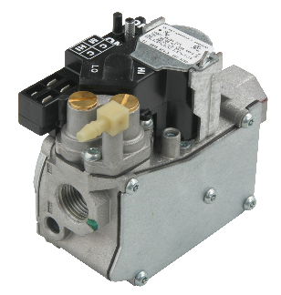
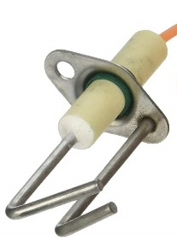
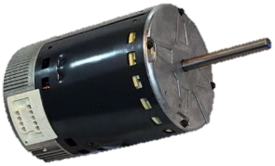
IFC Options / Differences
Ignition Types
Gas Valve Stages
Blower Motor Types
Hot Surface Ignition is operated with either Silicon Carbide of Silicon Nitride.
Direct Spark Ignition uses a spark probe to directly ignite burner gas.
Proven or Intermittent Pilot first checks for pilot ignition prior to opening up the main gas valve.
The most popular Furnaces manufactured are single stage but are also made with 2 heating stages or more. The most common are:
Single Stage use a single stage gas valve.
Two-Stage features a high/low fire gas valve. Usually staged open at 40% and then 100%
PSC or Permanent Split Capacitor motors were regulated out of new residential furnaces made after July 3rd, 2019
ECMx or X-13 motors use a controller to maintain constant torque on the blower shaft.
ECMv or Constant Speed motors use a controller to maintain a constant airflow speed.
21D83M-843 Single Stage IFC

Slide 17
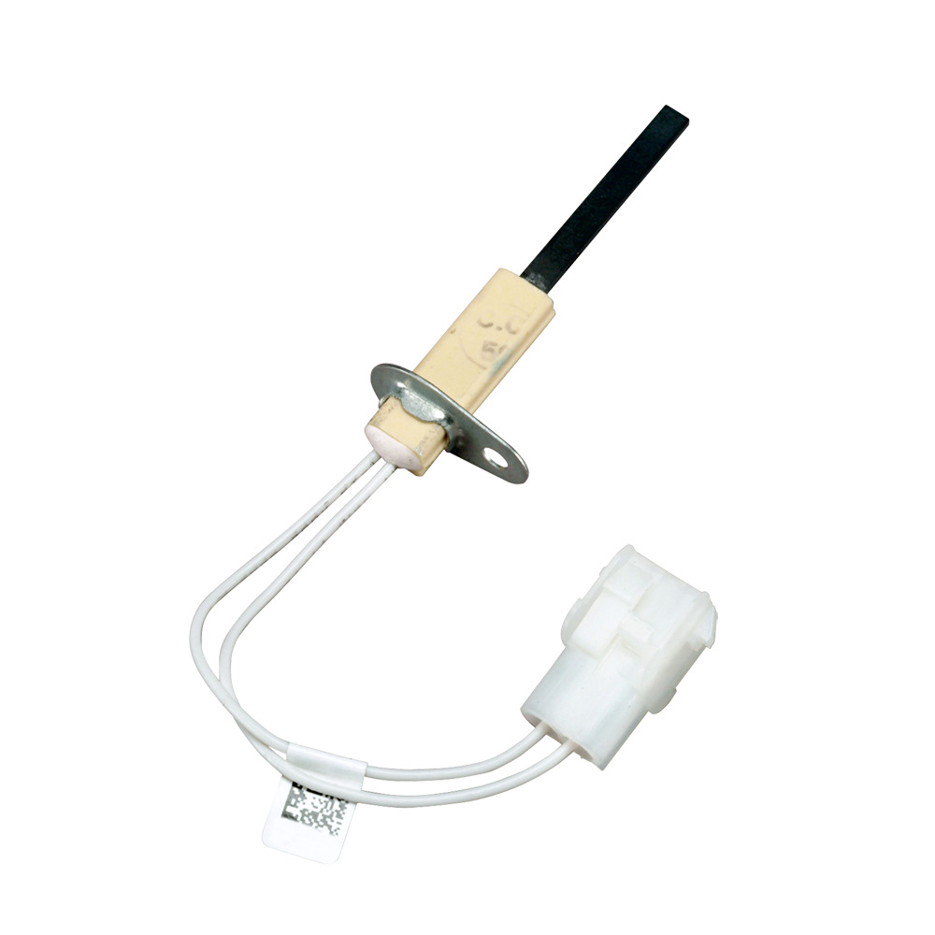

80V Hot Surface Ignitors
From about 1997 to 2006 many furnaces used integrated furnace controls featuring 80VAC ignitors, PSC inducer and blower motors and single stage gas valves. The 21D83M-843 is designed as a direct replacement for Lennox models fitting this profile.
Complete cross refence information is available on our website and in our mobile app to assure proper replacement control selection along with alternate control choices and detailed installation information.
Fast Facts 21D83-843
Lennox targeted replacement
80V Ignitor output
PSC Inducer and blower control
Single stage gas valve control
Heat, Cool, Fan, speed taps
R, C, W, Y, G Thermostat connection
Two conversion wiring harnesses and a quick connect breaker for increased application versatility
Mounting options include standoff or metal mounting plate
Detailed instruction sheet makes installation easy
TECH TIP: Some Lennox controls from this production era can also be replaced with a Universal Integrated Furnace Control like the 50M56U-843 featuring the HotRod ignitor
21D83M-843 Single Stage IFC

Slide 18
White-Rodgers Universal 50M56U-843 Components
24v Components:
Flame Sense Spade
12-pin Molex Connector
24v Thermostat Bus
Humidifier Spade
Status / Fault LED
Heat On/Off, Fan Dipswitches
120v Components:
PSC Blower Cool Spade
PSC Blower Heat Spade
PSC Blower Fan Only Spade
2 Extra Blower Speed Park Spades
Electronic Air Cleaner Spade
Line 120v Input Spade
120v Transformer Spade
120v Humidifier Spade
5 Line Neutral Spades
4-pin Inducer/Ignitor Molex Plug
7
8
9
10
12
13
11
14
16
15
6
4
2
1
5
3
21D83M-843
21D83M-843 Single Stage IFC

Slide 19
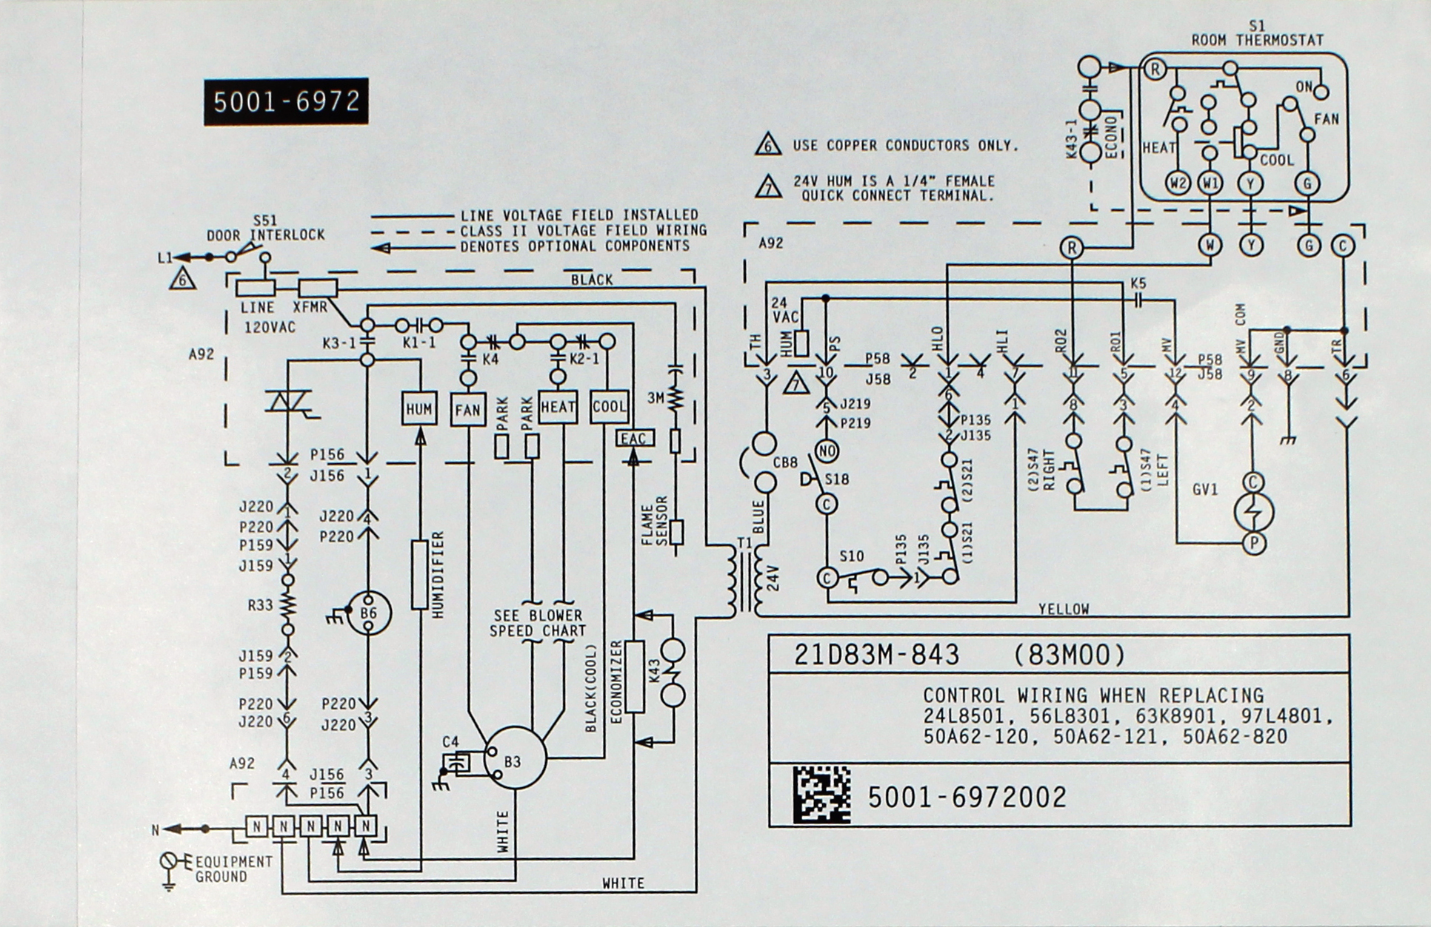
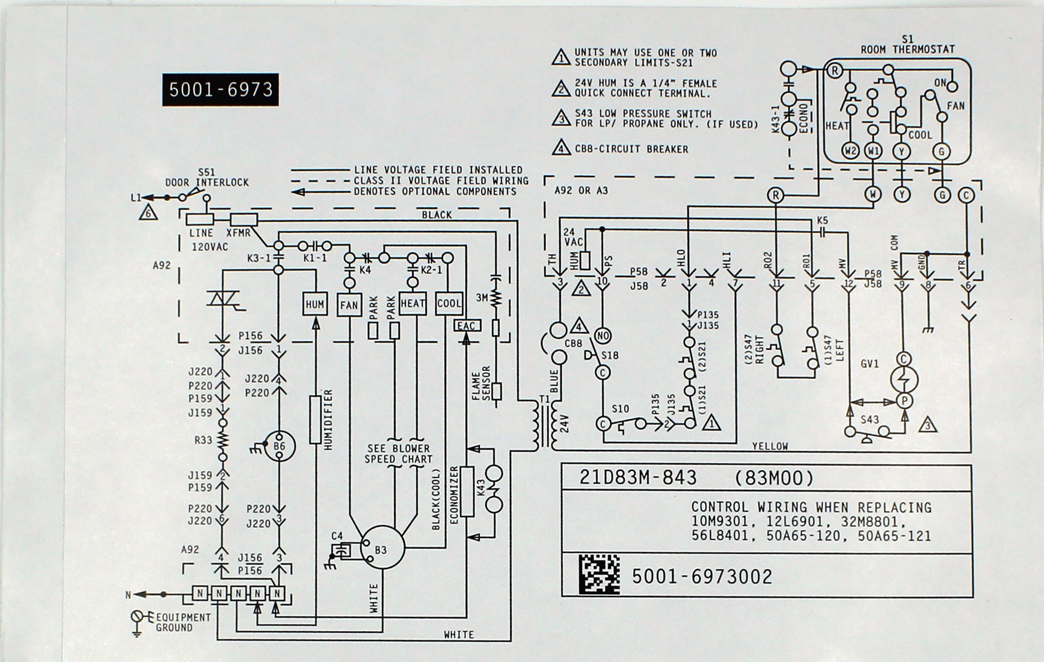
What’s In The Box?
Kit includes:
1 – Ignition control board
1 – Wiring harness adaptor (9-pin to 12-pin)
1 – Wiring harness adaptor (4-pin to 6-pin)
1 – Mounting panel
4 – Stand-off fasteners
1 – Circuit breaker
1 – 4" blue wire extension
2 – Wiring diagram labels
21D83M-843 Single Stage IFC

Slide 20

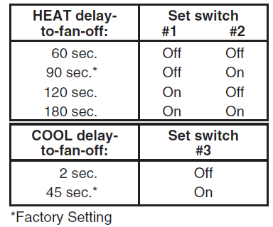
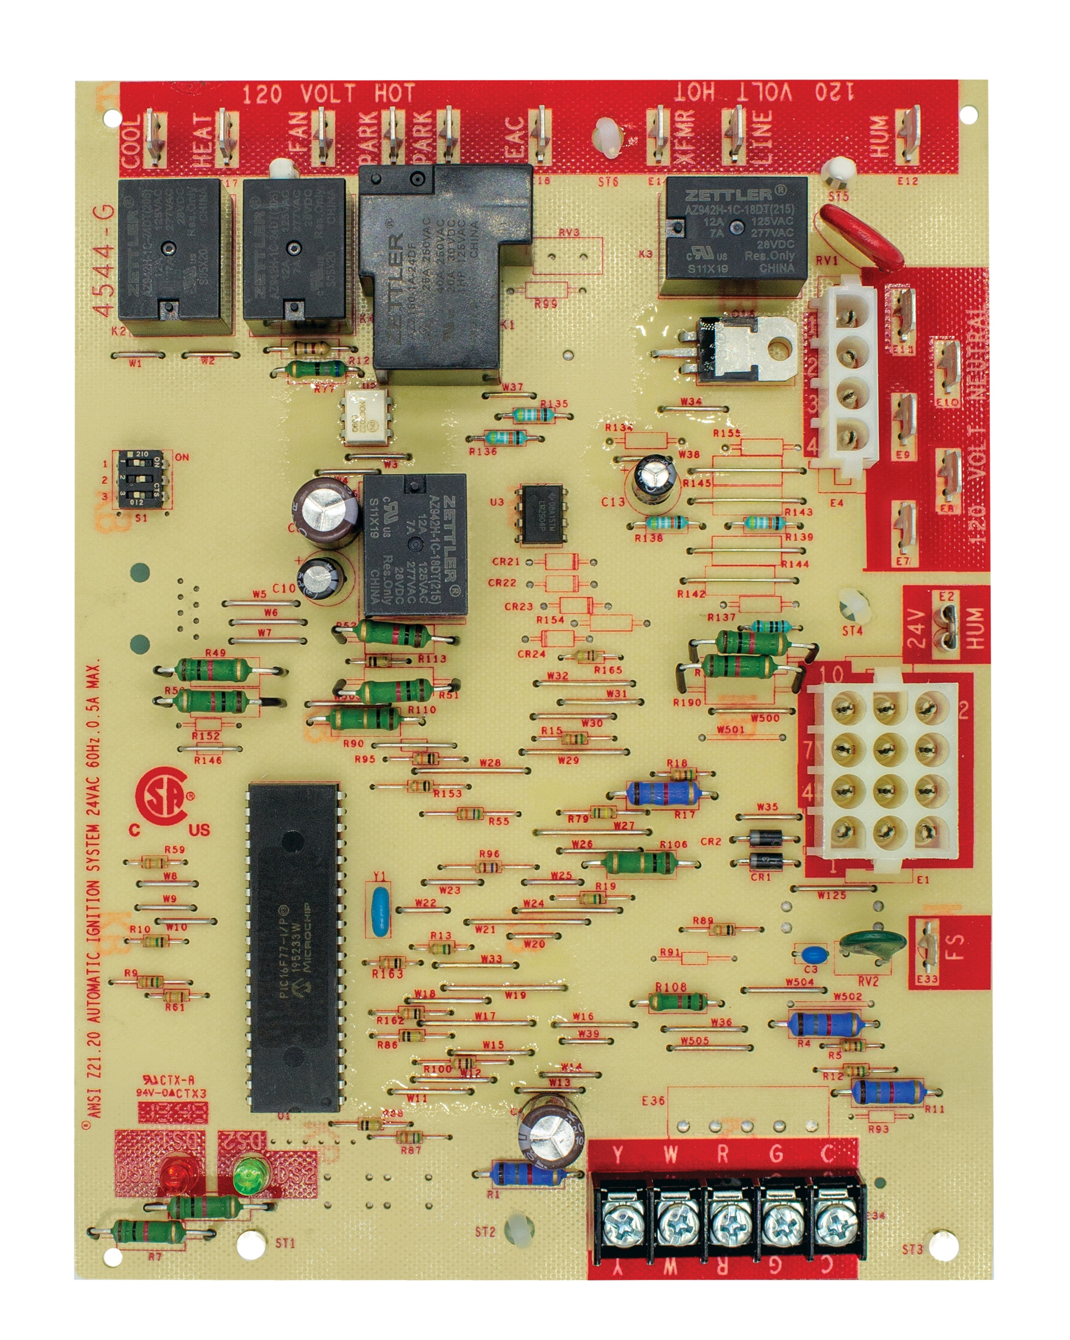
Adjustable Fan Delay Dipswitch Functions
Control has 1 set of dipswitches:
Dipswitch Settings
TECH TIP: Power must be cycled after dipswitch settings are made.
21D83M-843
21D83M-843 Single Stage IFC

Slide 21
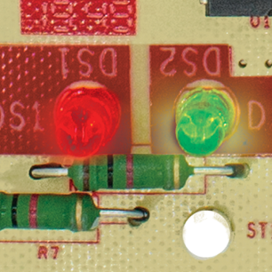
21D83M-843 Diagnostics
System troubleshooting is easy with dual LED diagnostics
DS 1 (Red LED) | DS 2 (Green LED) | Error/Condition
Simultaneous slow flash | Simultaneous slow flash | Normal operation
Simultaneous fast flash | Simultaneous fast flash | Normal operation with call for heat
Slow flash | On | Open limit switch
Off | Slow flash | Pressure switch stuck closed/open
Alternate slow flash | Alternate slow flash | External lockout (retries)
Slow flash | Off | Flame sensed with gas valve de-energized
On | Slow flash | Open rollout switch
On | On | Module – internal fault condition
Slow flash | Fast flash | Low flame sense current
Fast flash | Slow flash | Grounding or reversed polarity
Alternate fast flash | Alternate fast flash | Module ignitor contact failure
TECH TIP: 21D83 instructions also provides troubleshooting tips for each diagnostic flash code that occurs.
21D83M-843 Single Stage IFC
Notes:
The software code has been modified with new pressure switch criteria. When the pressure switch trips 3 times, there is a 3-hour lock-out.

Slide 22
Install

Slide 23
What’s In The Box?
Kit includes:
1 – Ignition control board
1 – Wiring harness adaptor (9-pin to 12-pin)
1 – Wiring harness adaptor (4-pin to 6-pin)
1 – Mounting panel
4 – Stand-off fasteners
1 – Circuit breaker
1 – 4" blue wire extension
2 – Wiring diagram labels
21D83M-843 Single Stage IFC

Slide 24
Replacement Procedure Summary
Using the installation guide, choose the correct replacement procedure based on the model being replaced.
Procedure 1 - Install mounting panel and breaker*
Procedure 2 - Install mounting panel, both conversion harnesses and
breaker*
Procedure 3 - Direct board replacement, no kit components required
For this tutorial, procedure 2 will be used.
* Breaker only required on furnaces without low voltage fuse or breaker.
TECH TIP: Once the board has been cross-referenced, instructions clearly illustrate steps.
21D83M-843 Single Stage IFC

Slide 25
Find Correct Replacement Procedure
Locate the old board number being replaced in the 21D83M instructions (summary below).
Old Board Number | Replacement Procedure #
100925-01 | 3
100925-02 | 3
100925-03 | 3
10M93 | 1
10M9301 | 1
124110 | 3
12L69 | 1
12L6901 | 1
17W92 | 3
17W9201 | 3
21D83M-843 | 3
23W51 | 3
23W5101 | 3
24L85 | 2
24L8501 | 2
Old Board Number | Replacement Procedure #
30W25 | 3
30W2501 | 3
32M88 | 1
32M8801 | 1
50A62-120 | 2
50A62-121 | 2
50A62-820 | 2
50A65-120 | 1
50A65-121 | 1
50A66-122 | 3
50A66-123 | 3
50A66-743 | 3
50A66-843 | 3
56L83 | 2
56L8301 | 2
Old Board Number | Replacement Procedure #
56L84 | 1
56L8401 | 1
63K89 | 2
63K8901 | 2
65867 | 3
69M08 | 3
69M0801 | 3
69M15 | 3
69M1501 | 3
83M00 | 3
83M001 | 3
97L48 | 2
97L4801 | 2
21D83M-843 Single Stage IFC

Slide 26
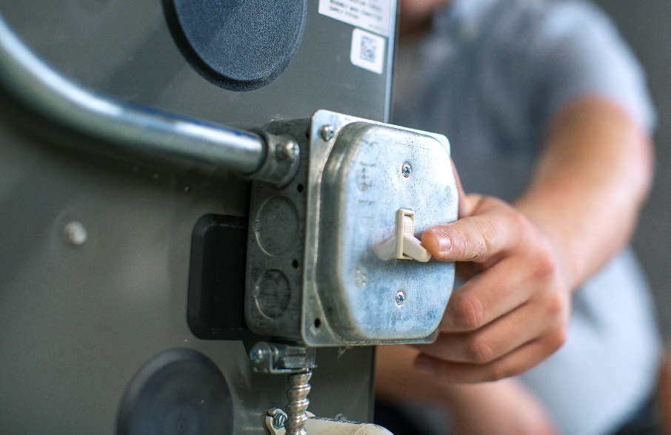
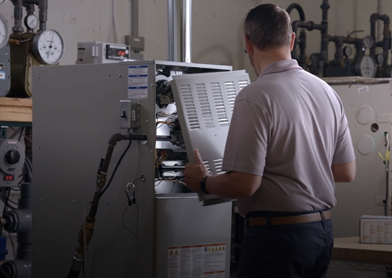
Disconnect Power and Gas
1
Turn off the power and gas to the furnace and remove the access panels.
21D83M-843 Single Stage IFC

Slide 27

Check Cross Reference
2
Check the old part number against the 21D83-843 box cross reference or WR Mobile.
21D83M-843 Single Stage IFC

Slide 28
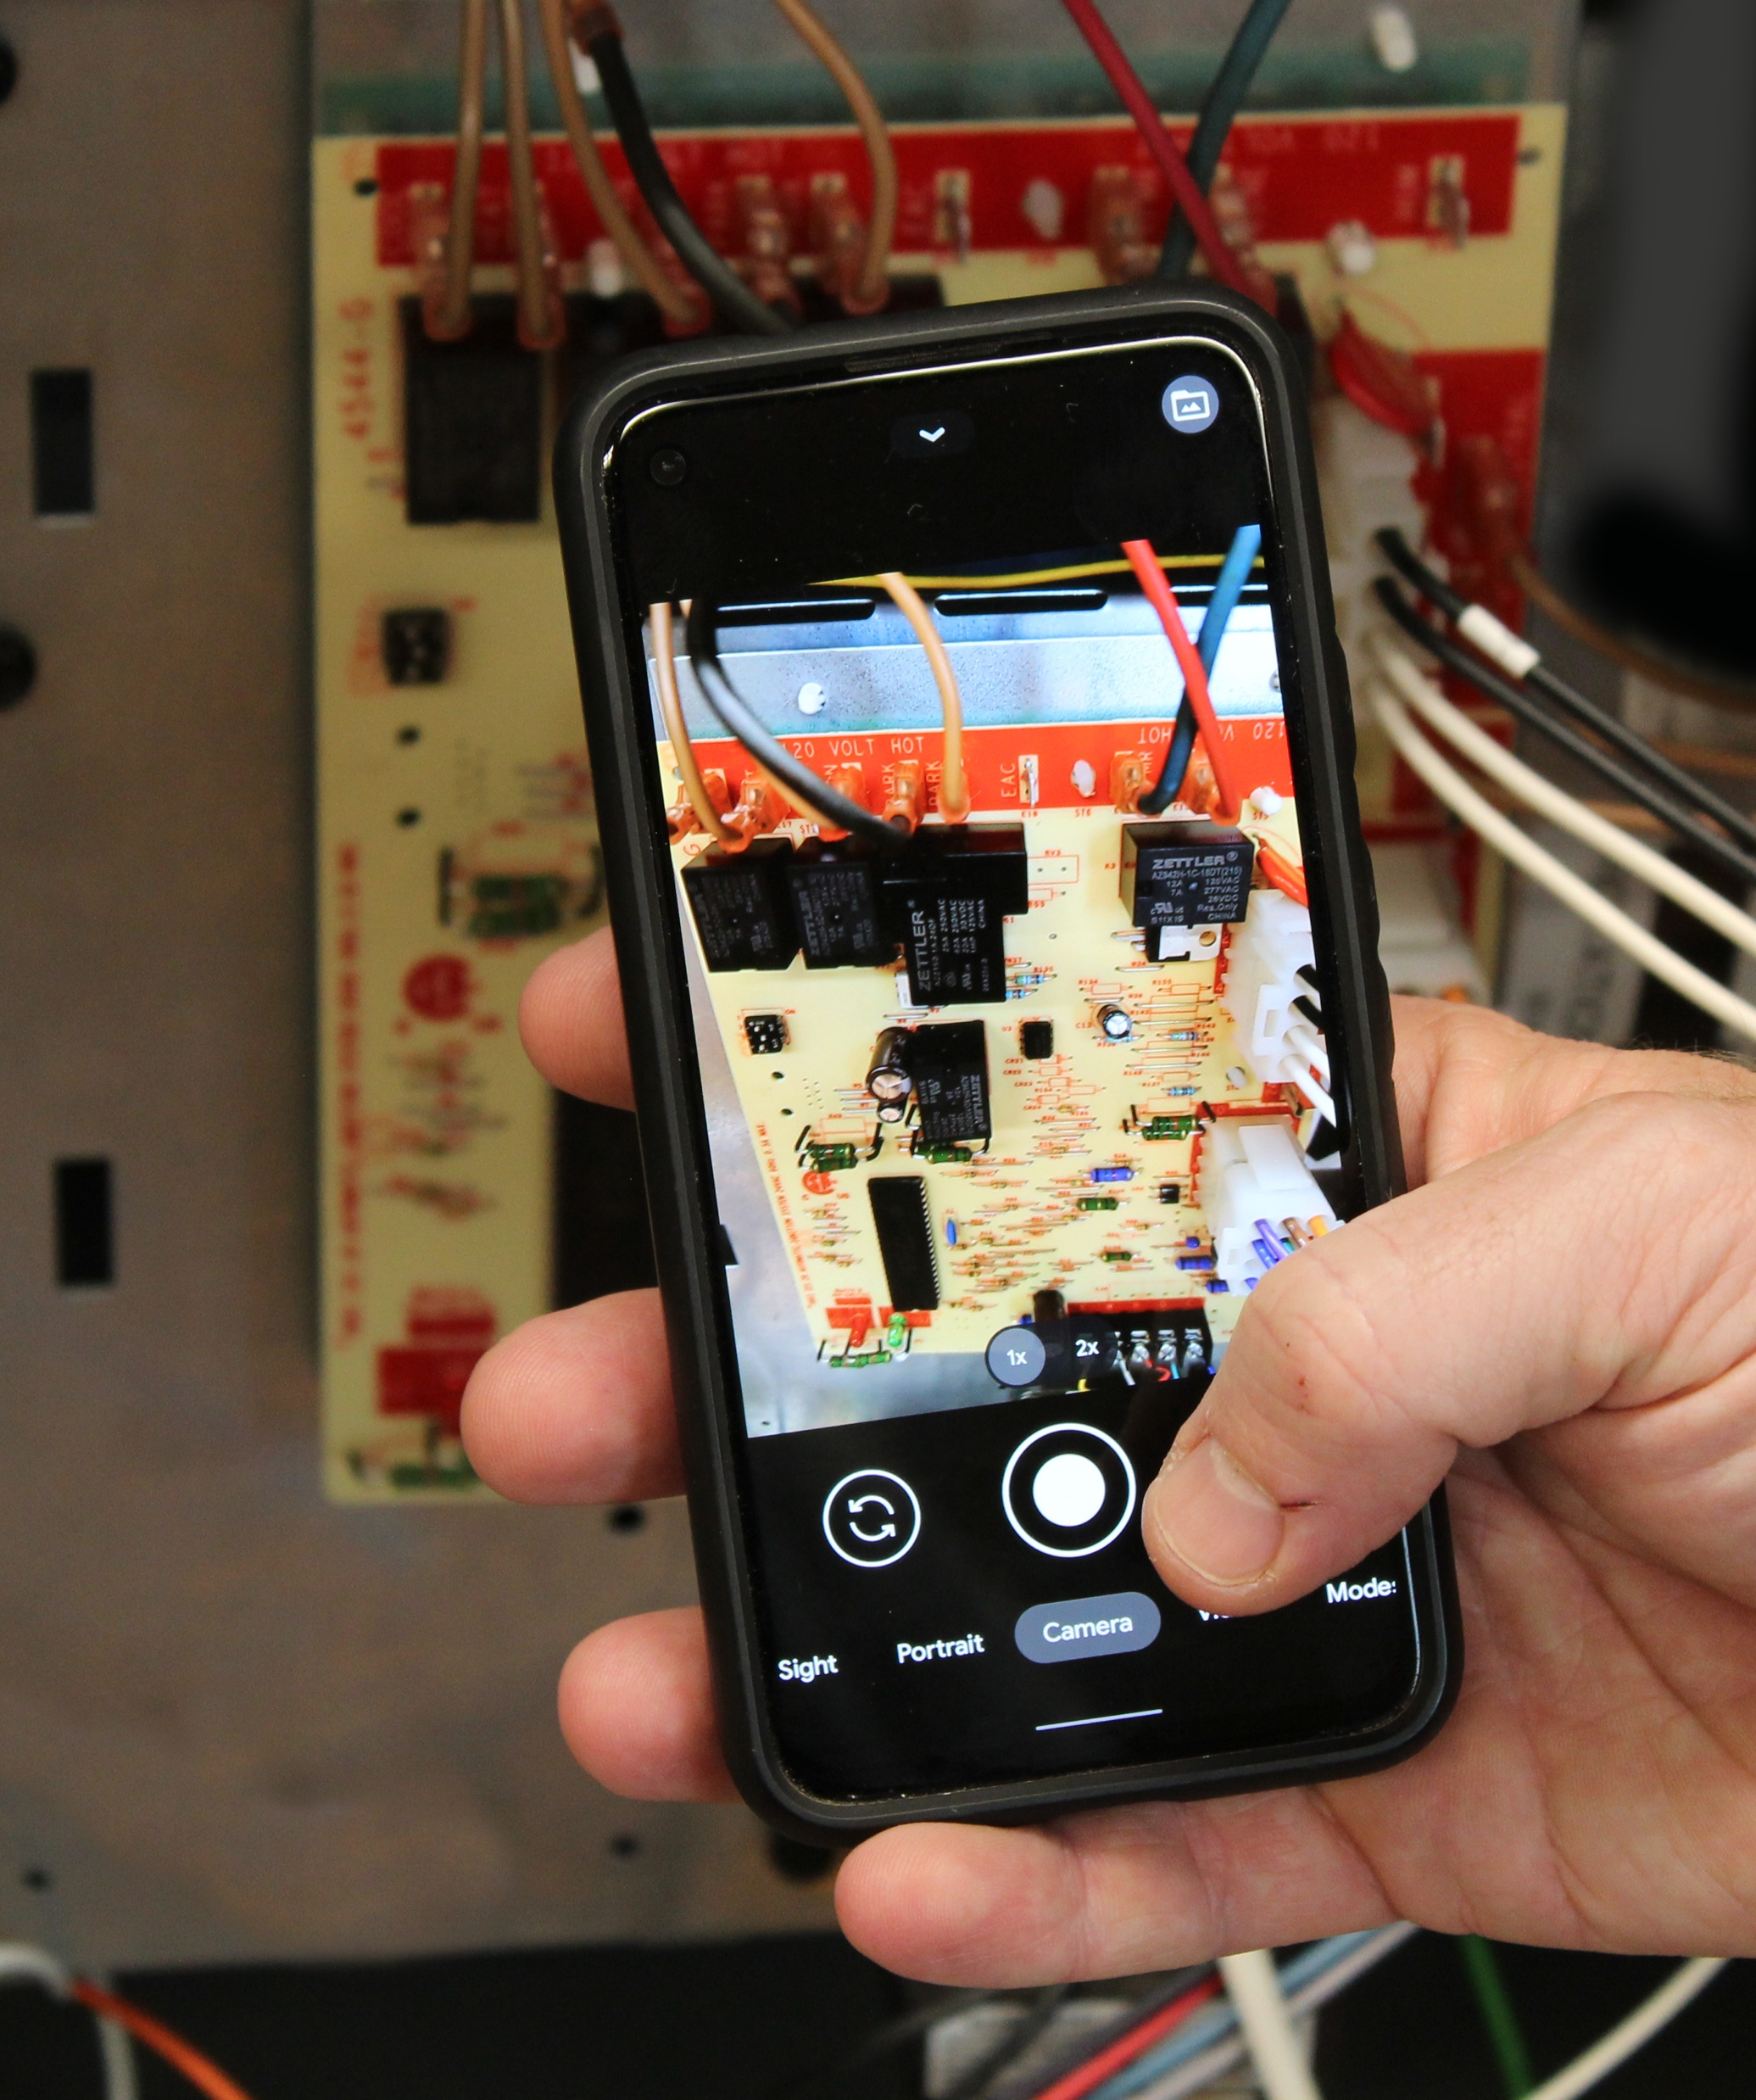
Take a Picture of Wiring
3
Take pictures before removing any wiring. Label existing wiring, as necessary.
21D83M-843 Single Stage IFC

Slide 29
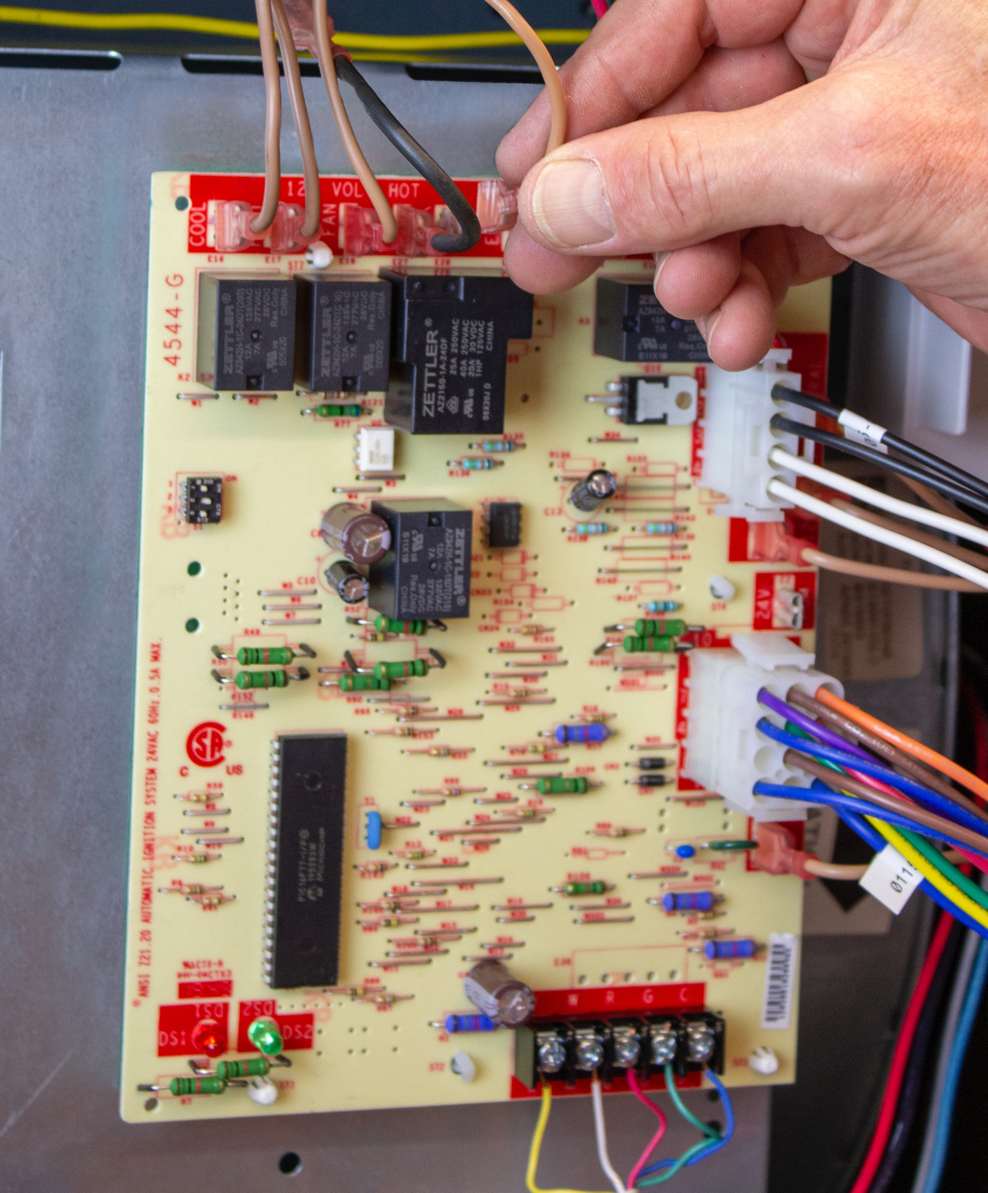
Disconnect Wiring
4
Flame sense connection
Molex connectors
Thermostat wiring
Blower motor wires
120V line voltage connections
Transformer connections
Remove the old board
21D83M-843 Single Stage IFC

Slide 30
Dipswitch Settings
5
Set fan delay dipswitches to match the old control settings.
TECH TIP: The switches can be moved with a small screwdriver.
21D83M-843 Single Stage IFC

Slide 31
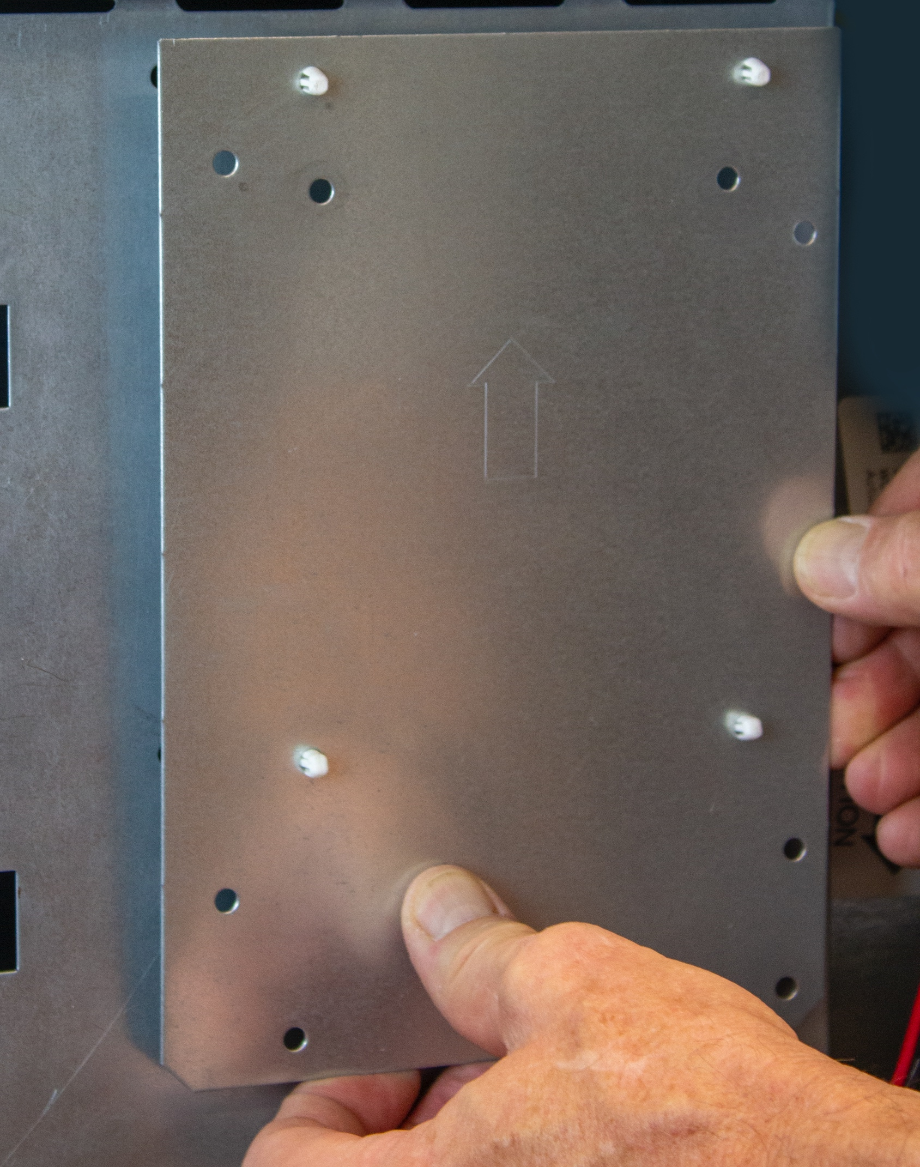
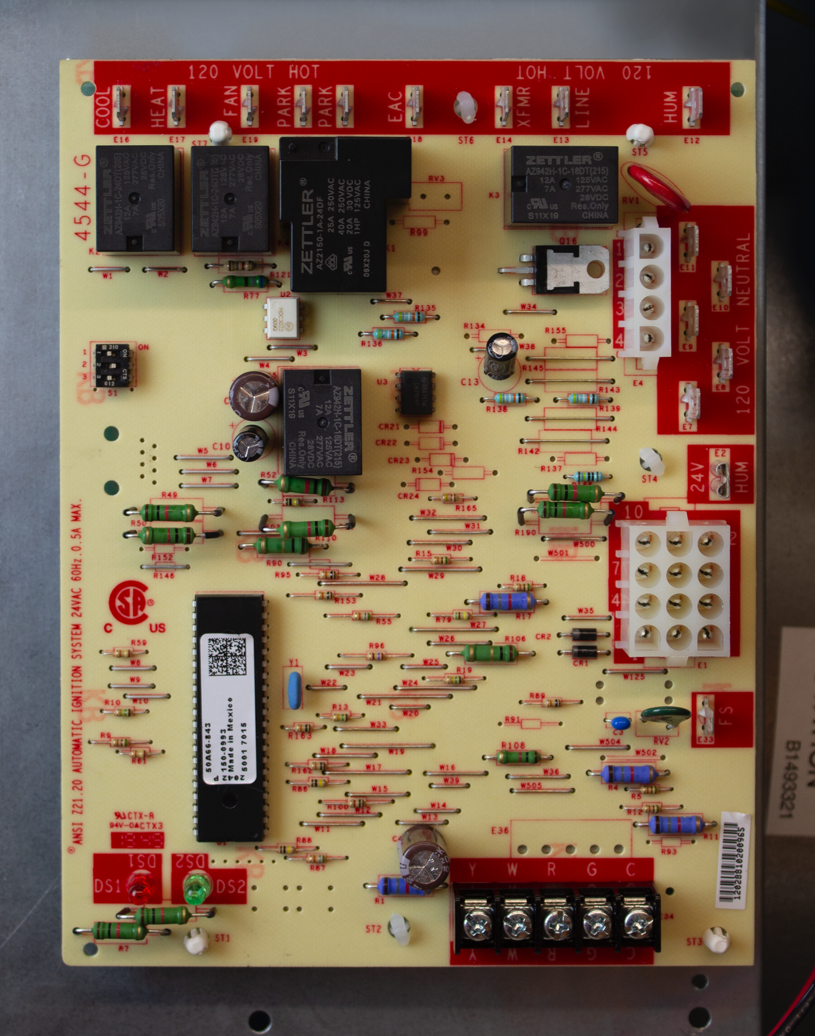
Mount Board
6
Mount the new board using the old mounting holes, new mounting plate or re-drilling procedure.
21D83M-843 Single Stage IFC

Slide 32
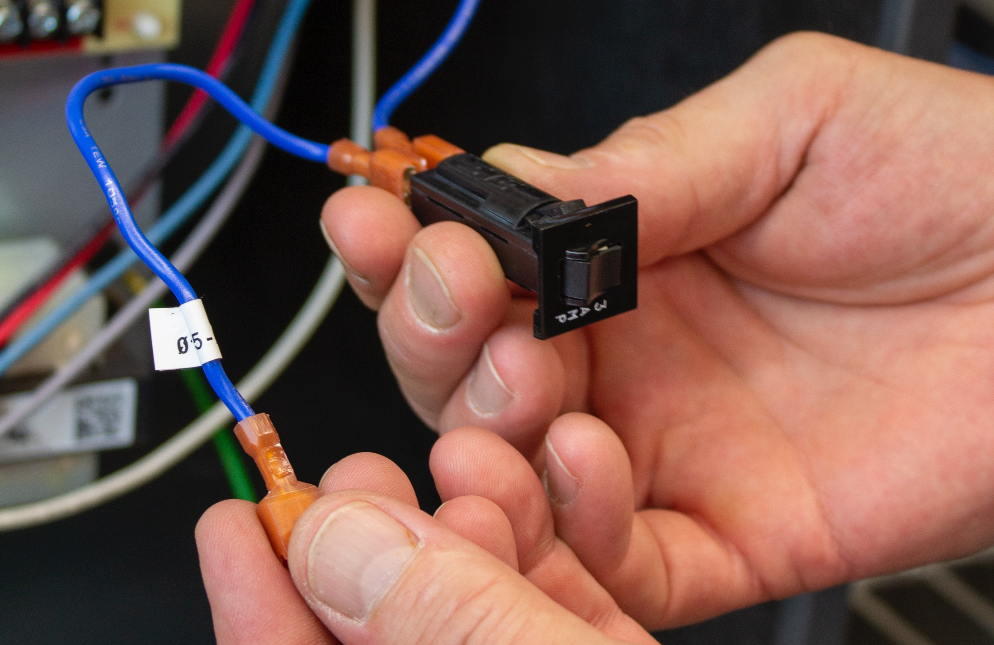
Circuit Breaker
7
On furnaces without a low voltage fuse or breaker insert the included circuit breaker in series between the blue wire on Pin 3 of the wiring harness (9-pin to 12-pin) and the blue transformer wire. Use the 4" blue wire provided for transformers with a quick-connect terminal.
21D83M-843 Single Stage IFC

Slide 33
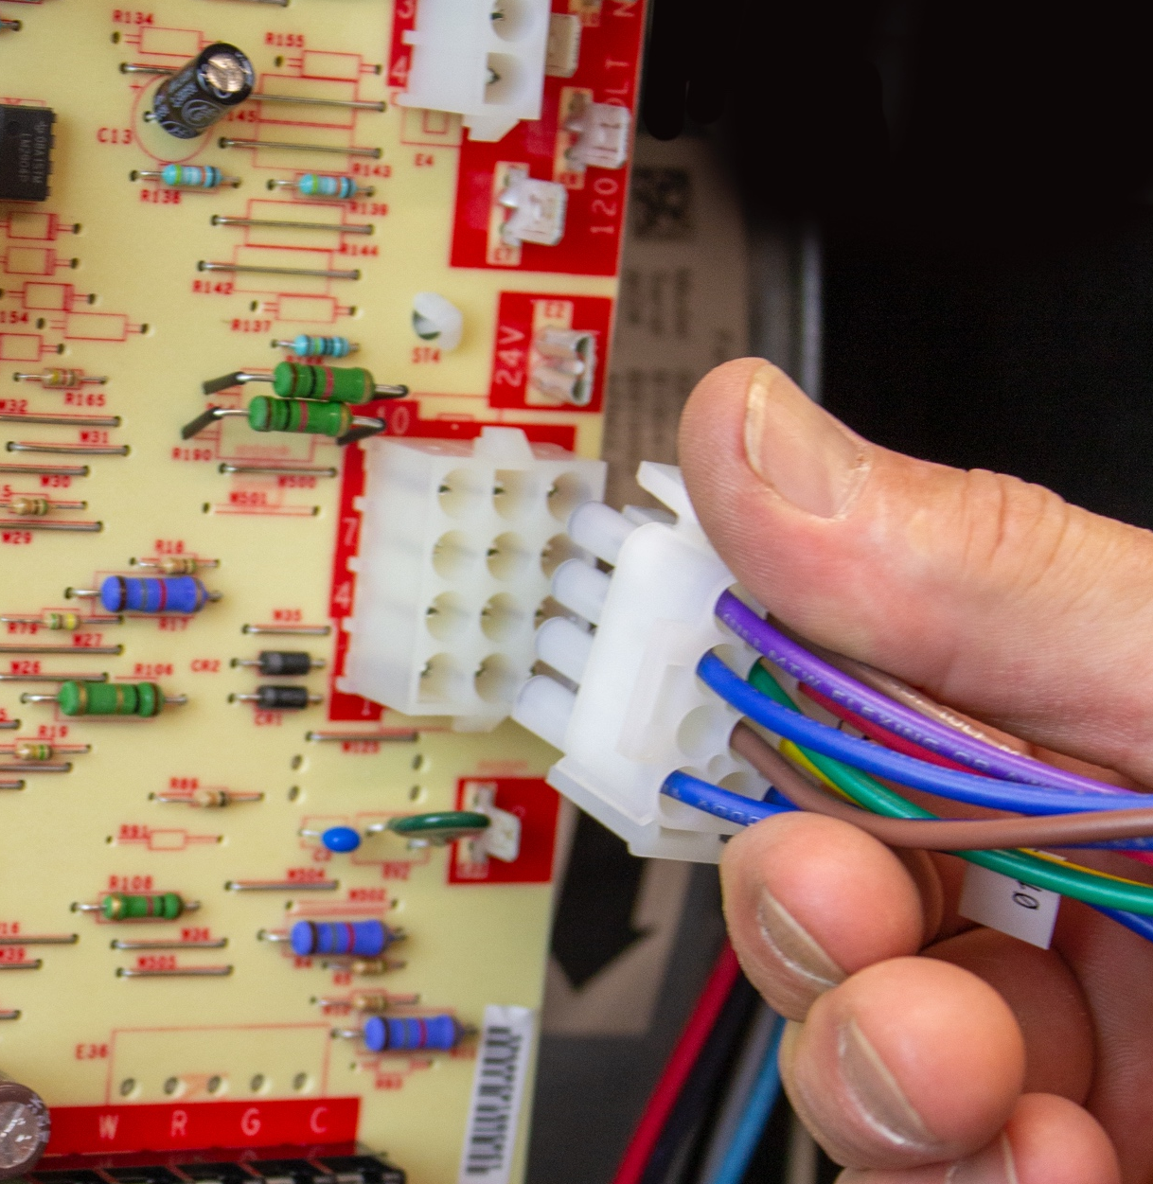
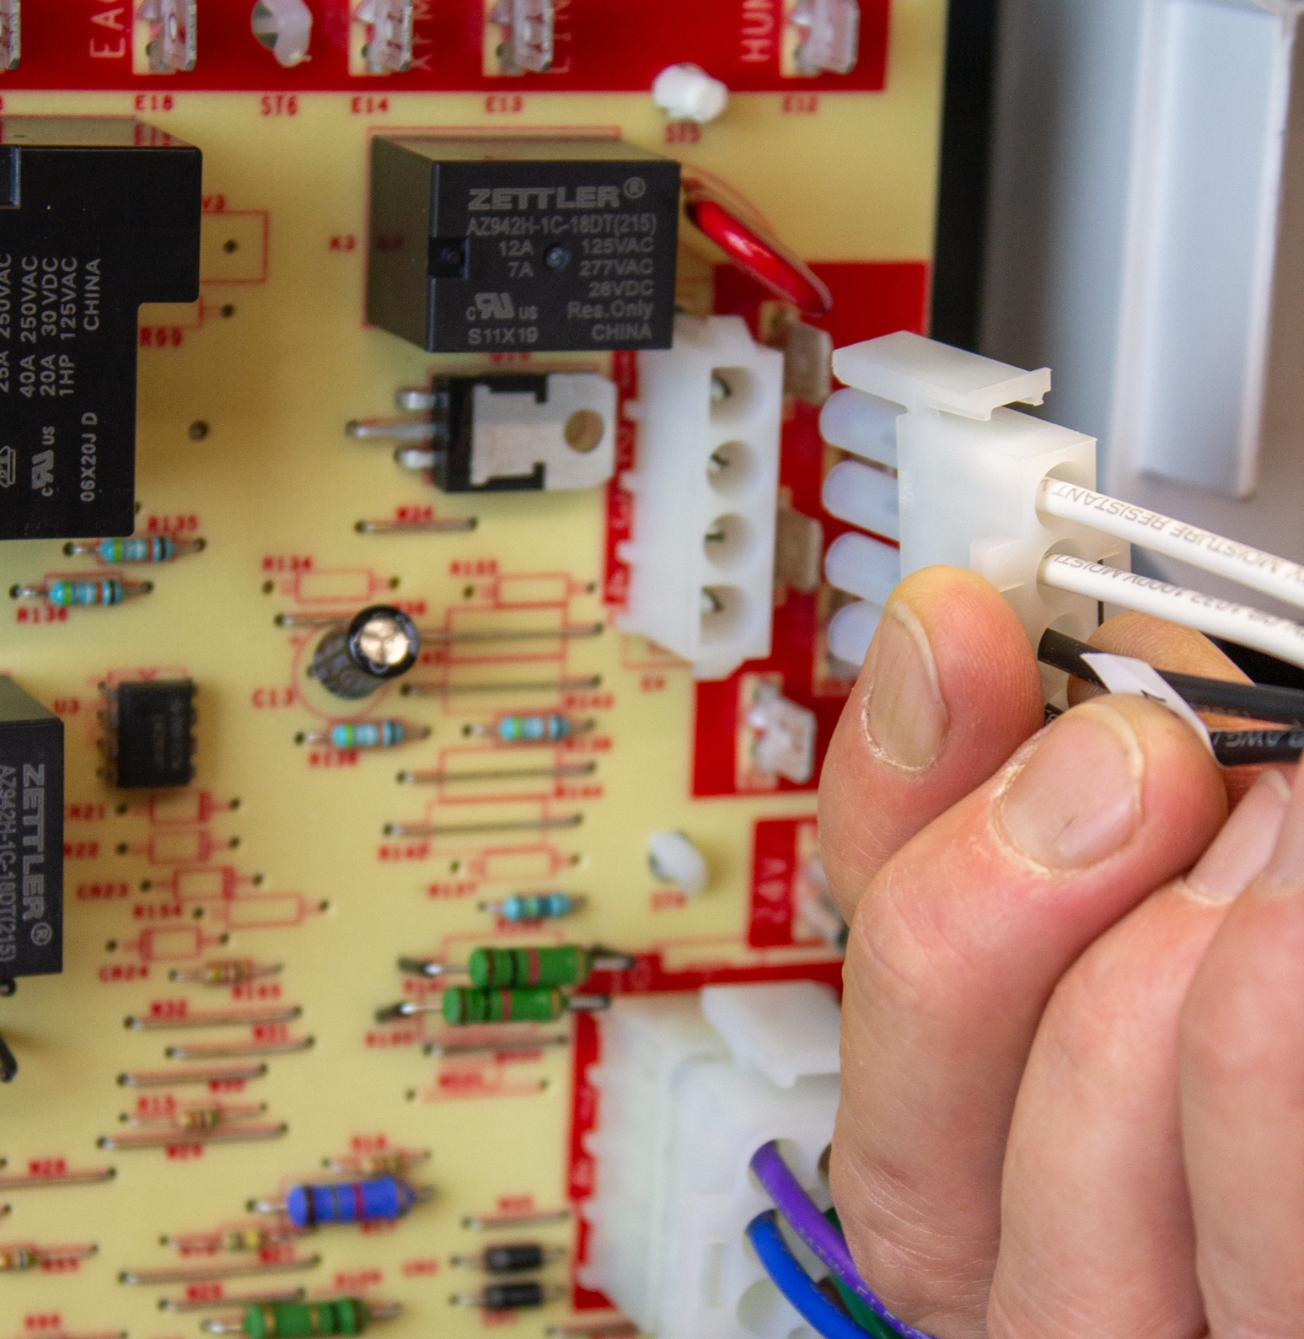
Connect Wiring Harnesses
8
Connect the provided 9-pin to 12-pin wiring harness to the unit 9-pin connector. Connect the provided 4-pin to 6-pin wiring harness to the unit 6-pin connector.
21D83M-843 Single Stage IFC

Slide 34
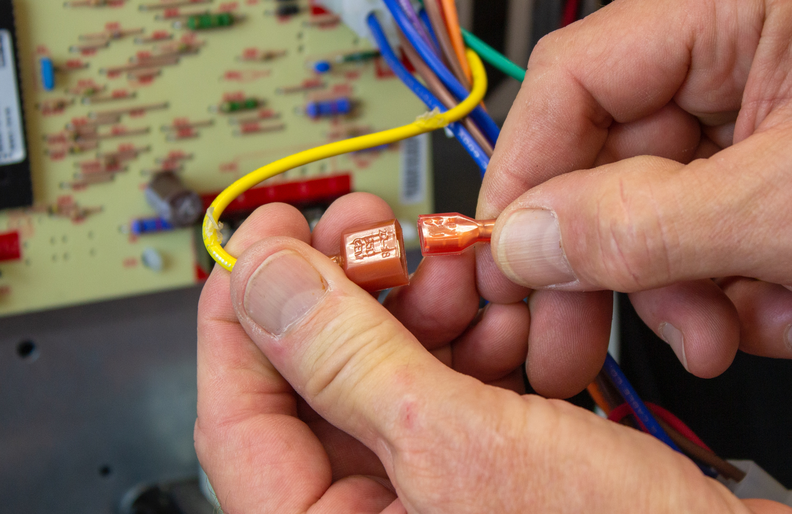
Connect Transformer Wire
9
Connect the yellow wire from position 6 on the 12-pin connector to the yellow transformer wire.
21D83M-843 Single Stage IFC

Slide 35
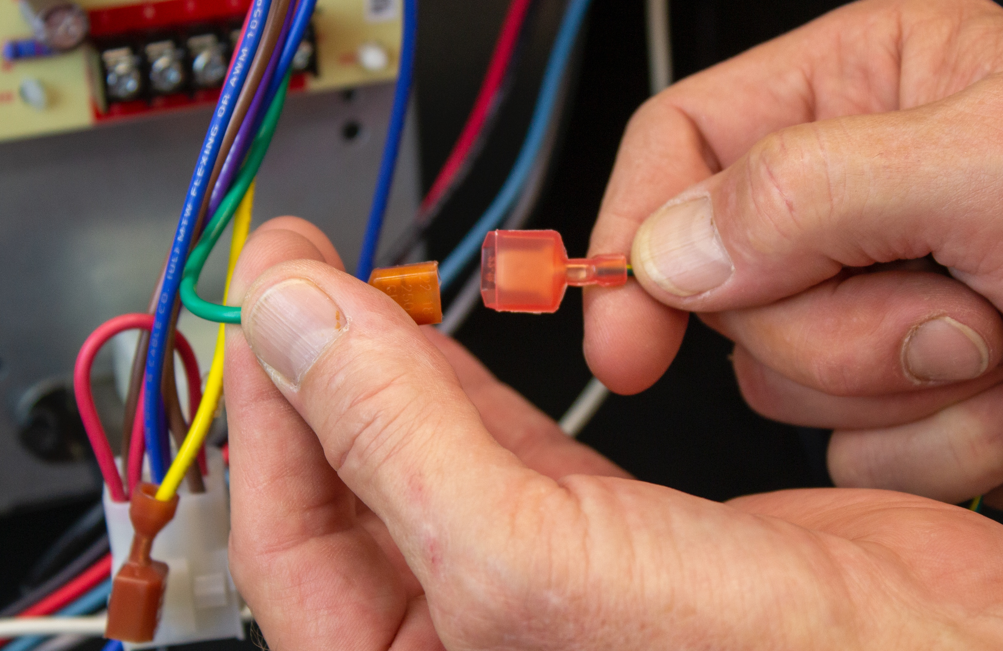
Connect GND
10
Connect GND wire to equipment ground.
21D83M-843 Single Stage IFC

Slide 36
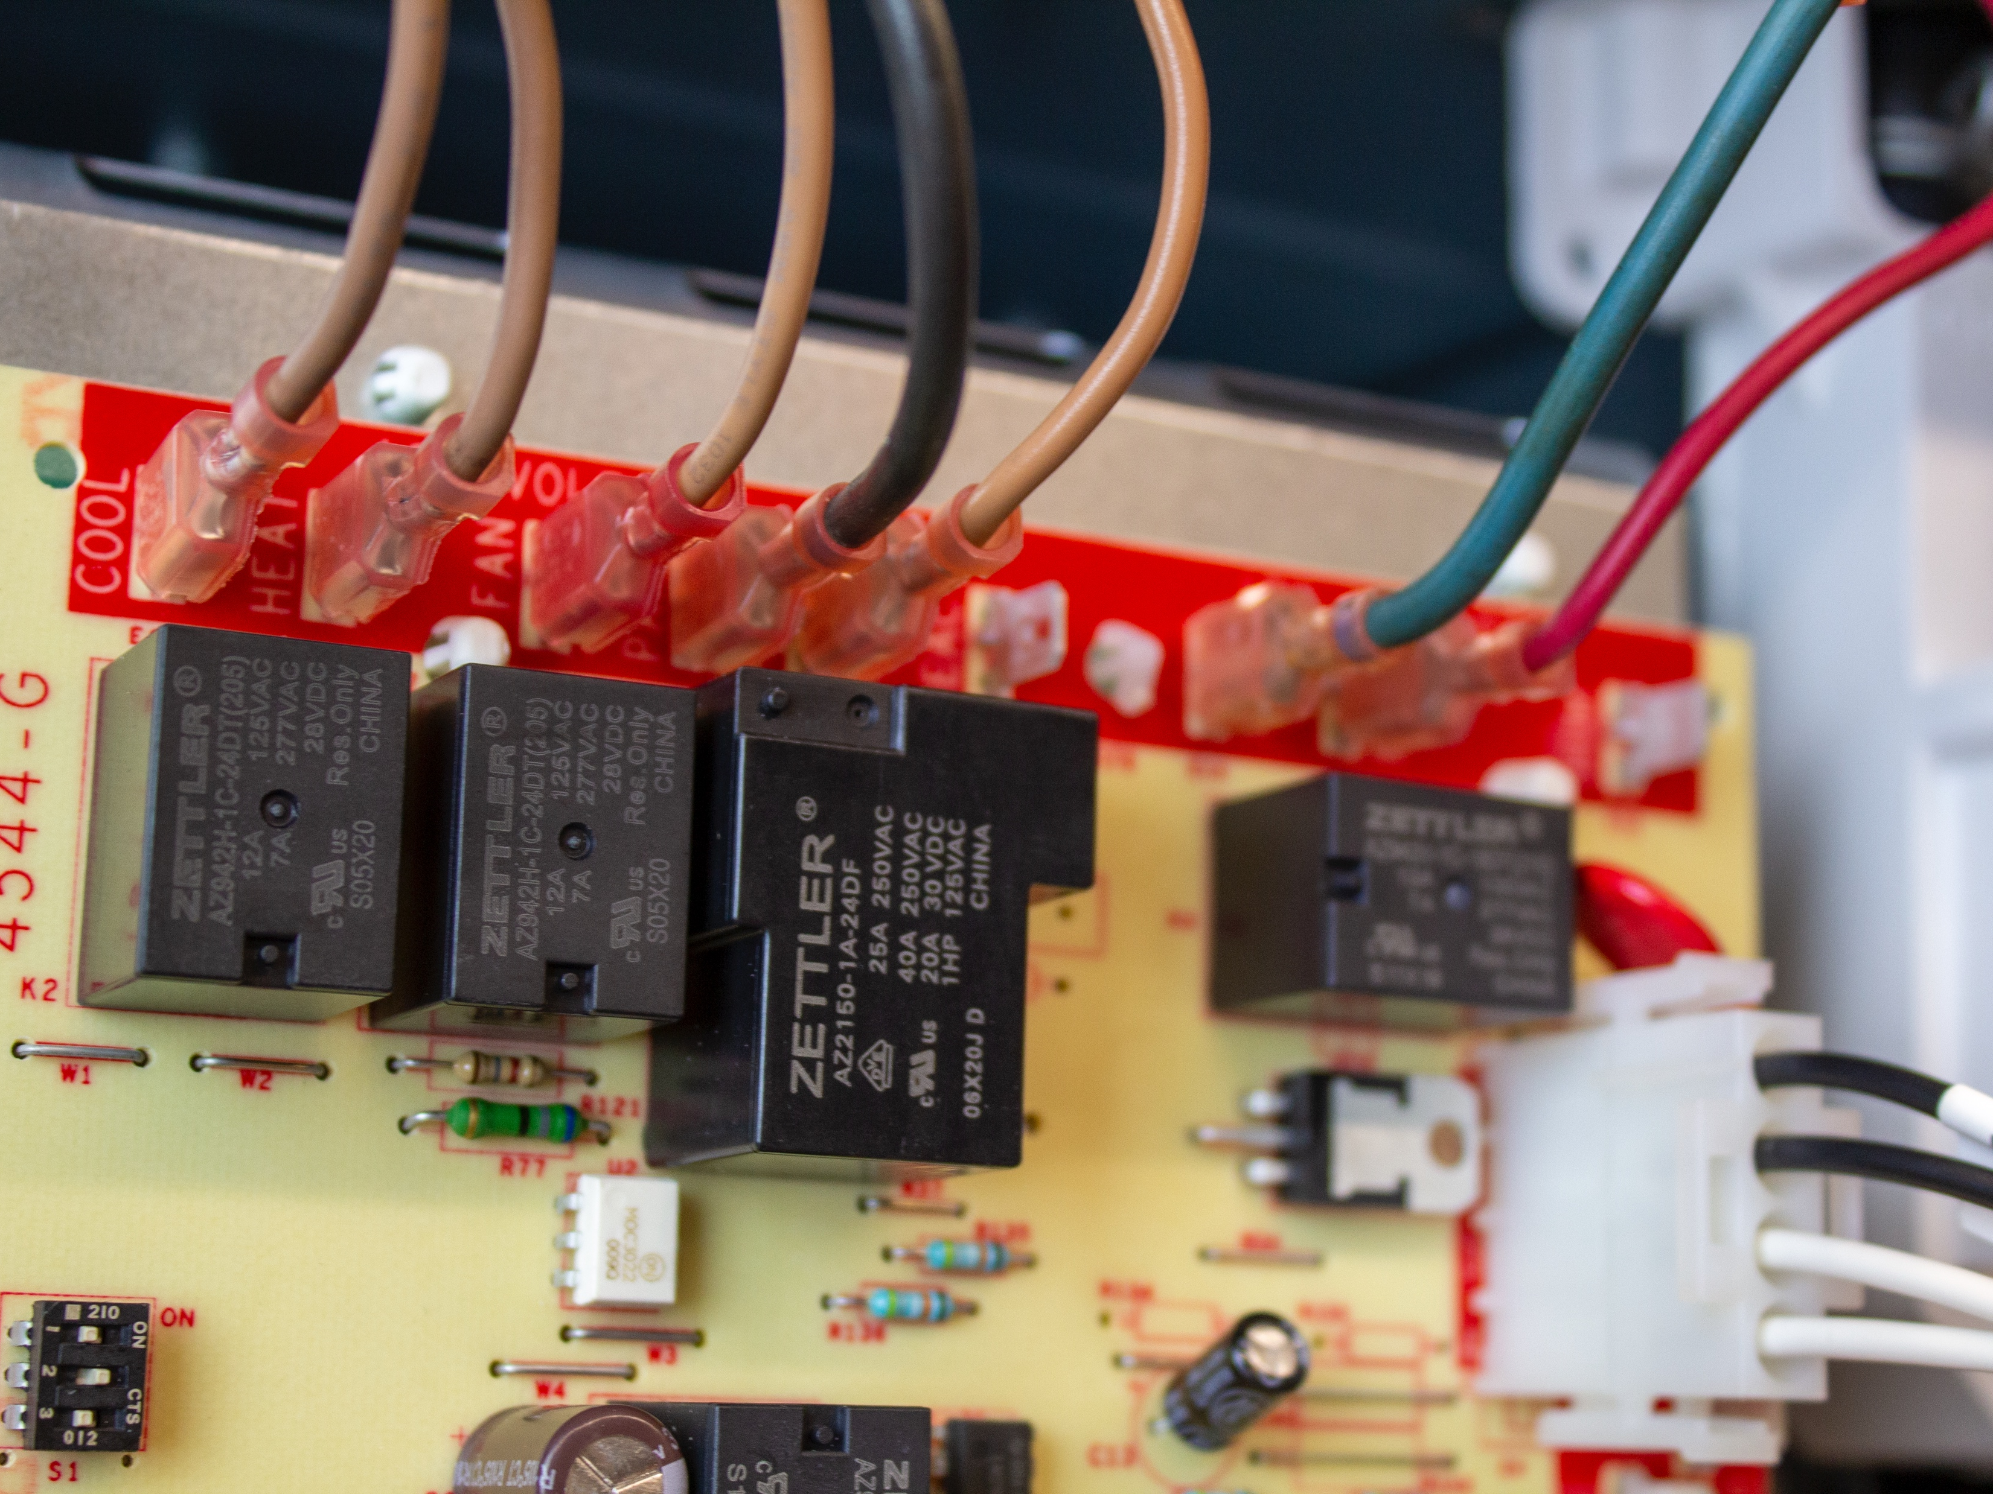
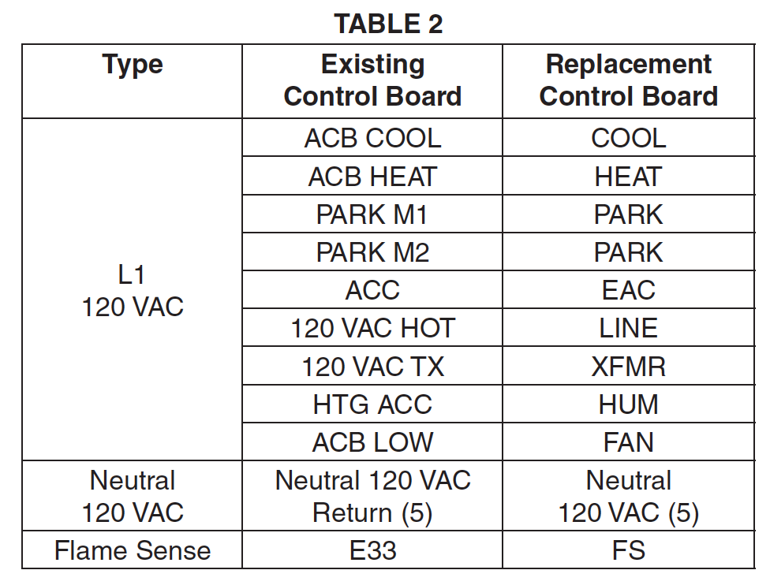
Connect Remaining Wires
11
Connect the remaining 120 VAC hot and neutral wires and the flame sense wire to the replacement control per table 2.
21D83M-843 Single Stage IFC

Slide 37
Wiring Diagram
12
Affix wiring diagram 5001-6972 adjacent to the existing unit wiring diagram
21D83M-843 Single Stage IFC

Slide 38
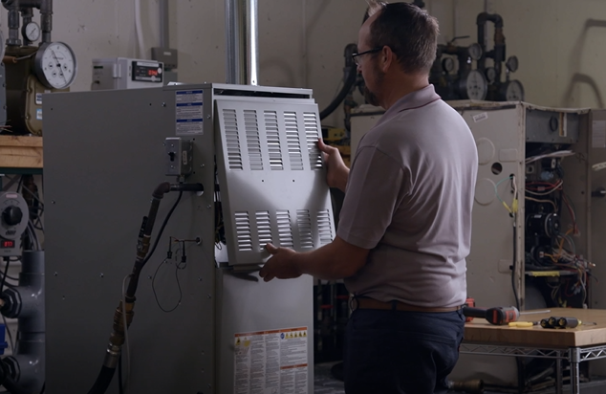
Connect Power and Gas
13
Replace the access panel. Restore the electrical power and gas supply. Refer to the furnace installation instructions for start-up and check-out procedures.
21D83M-843 Single Stage IFC

Slide 39
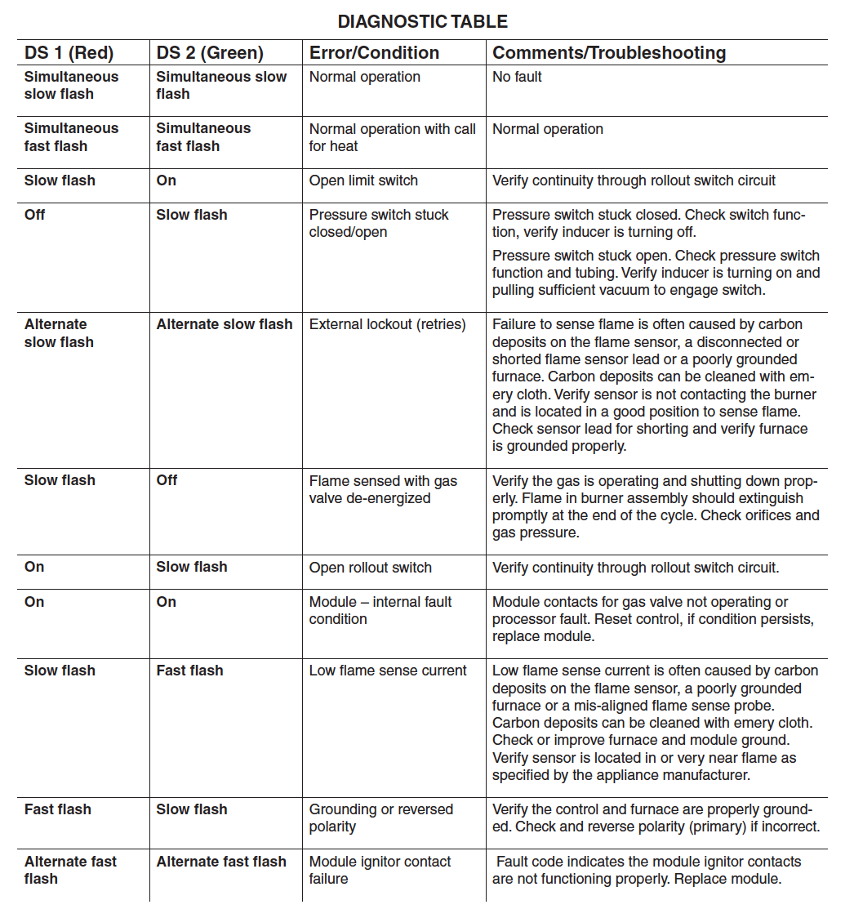
Troubleshooting
See page 7 of the installation guide.
21D83M-843 Single Stage IFC
R-5408

